Slide 1
Scots pine blister rust
Sentinel Plant Network Pest/Pathogen Series
Notes:
This presentation will introduce you to Scots pine blister rust, a disease that occurs throughout Eurasia but that is not known to be in North America. Because many herbaceous and coniferous hosts of the disease in Europe are closely related to plants growing in North America, USDA scientists have become concerned that this pathogen could be introduced to our continent on infected plants moving in trade. Thus, USDA inspectors continue to survey for the pathogen and are looking forward to collaborative assistance from members of the Sentinel Plant Network, especially those cultivating pine collections. Monitoring for Scots pine blister rust will be tricky because the disease progresses slowly and early symptoms may easily be overlooked.
The text provided in the notes section is not meant to be read verbatim to the audience. It is meant to provide the speaker with the necessary background information to support what is presented on each slide.

Slide 2
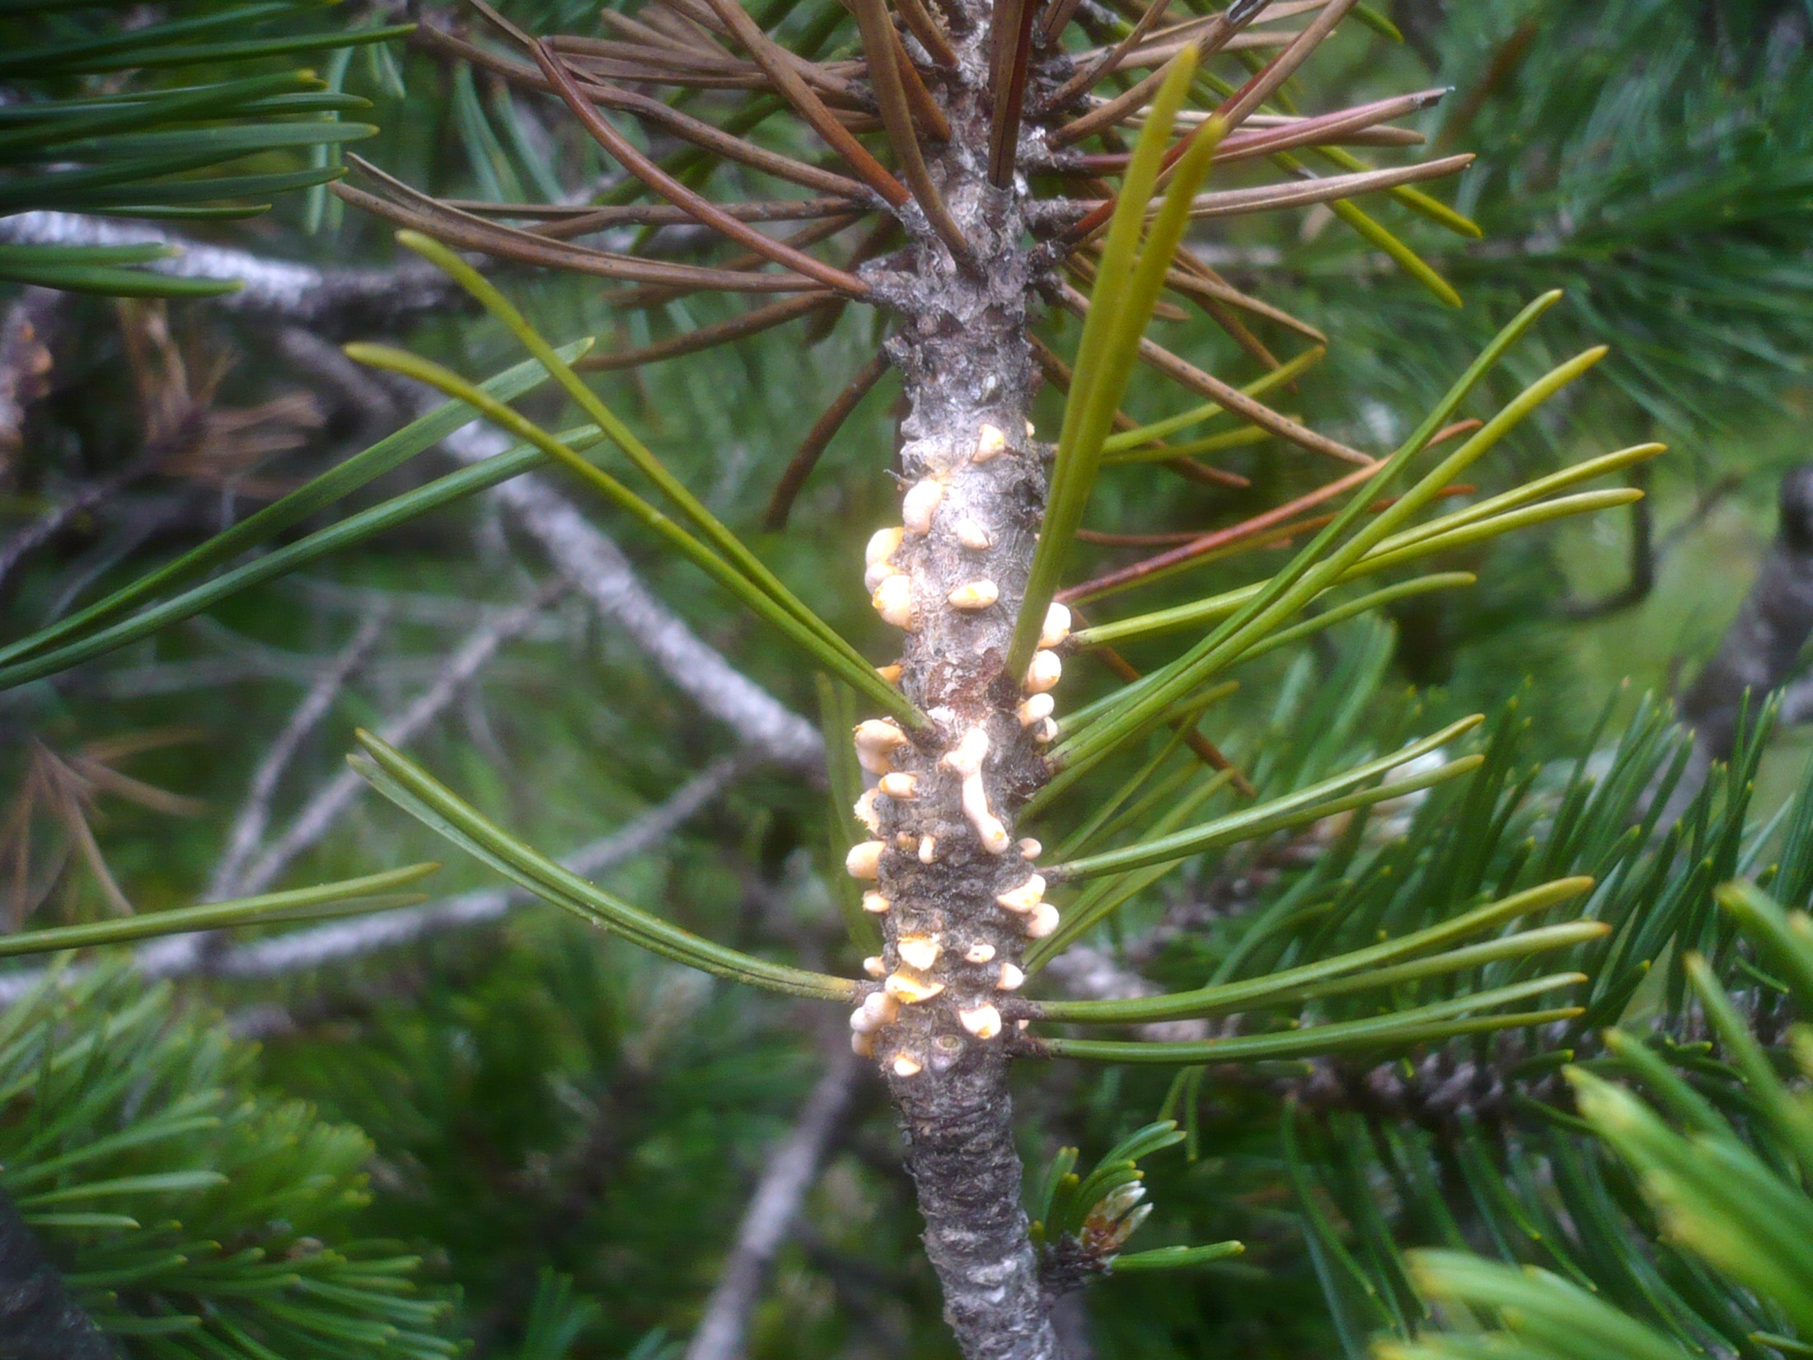
Scots Pine Blister Rust
Synonyms include: resin-top disease, resin-top, Scotch pine blister rust, Cronartium rust, two-needle pine blister rust
Photo: Cronartium flaccidum on mugo pine © Gerhard Koller, the mushroom observer
Notes:
Scots pine blister rust, also called resin top disease and two-needle pine blister rust, is a disease that affects several pines with needles in bunches of 2s and 3s, collectively known as "hard" pines. Scots pine is obviously one of the hard pines but many other common and economically important pines are also potential hosts in North America. These trees are already known to be susceptible to other rust diseases of consequence so likely you have experience recognizing some characteristics diagnostic for this group.

Slide 3
Scots Pine Blister Rust Objectives
Background
Potential impact
Pathways
Pathogen biology
Hosts
Signs and symptoms
Scouting
Suspects? What to do…
Submitting samples
Notes:
In this presentation you will learn the history of Scots pine blister rust and discuss its potential impact if it is introduced to North America. You will also learn about the biology of the pathogens and their most likely pathways for introduction into the US.
Additionally we will cover the hosts likely to be associated with this disease, how to recognize signs and symptoms and what to do if you suspect that a plant may have it.

Slide 4
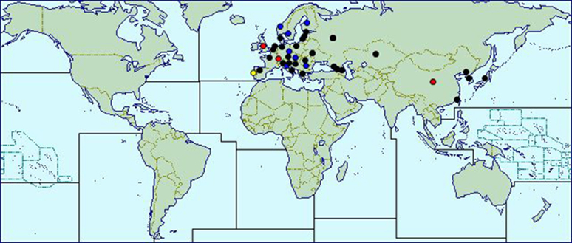
Background
Blister rusts have reduced forest productivity for centuries
Currently Scots pine blister rust is widely distributed across Eurasia
Many susceptible trees in temperate forests of North America and in Southern Hemisphere
Map source: http://www.cabi.org/isc/datasheet/16148
Notes:
Blister rusts have long been major factors in reducing forest productivity. Scots pine blister rust is widely distributed across Eurasia and has been described as “severe,” “rapidly advancing” and “dangerous.” The disease caused catastrophic losses in some Mediterranean region forests in the 1960’s and 1970’s (CPHST Pest Datasheet).
Although the disease has not been detected in North America, many susceptible trees in temperate forests of North America and the Southern Hemisphere could be at risk if it were to be introduced.

Slide 5
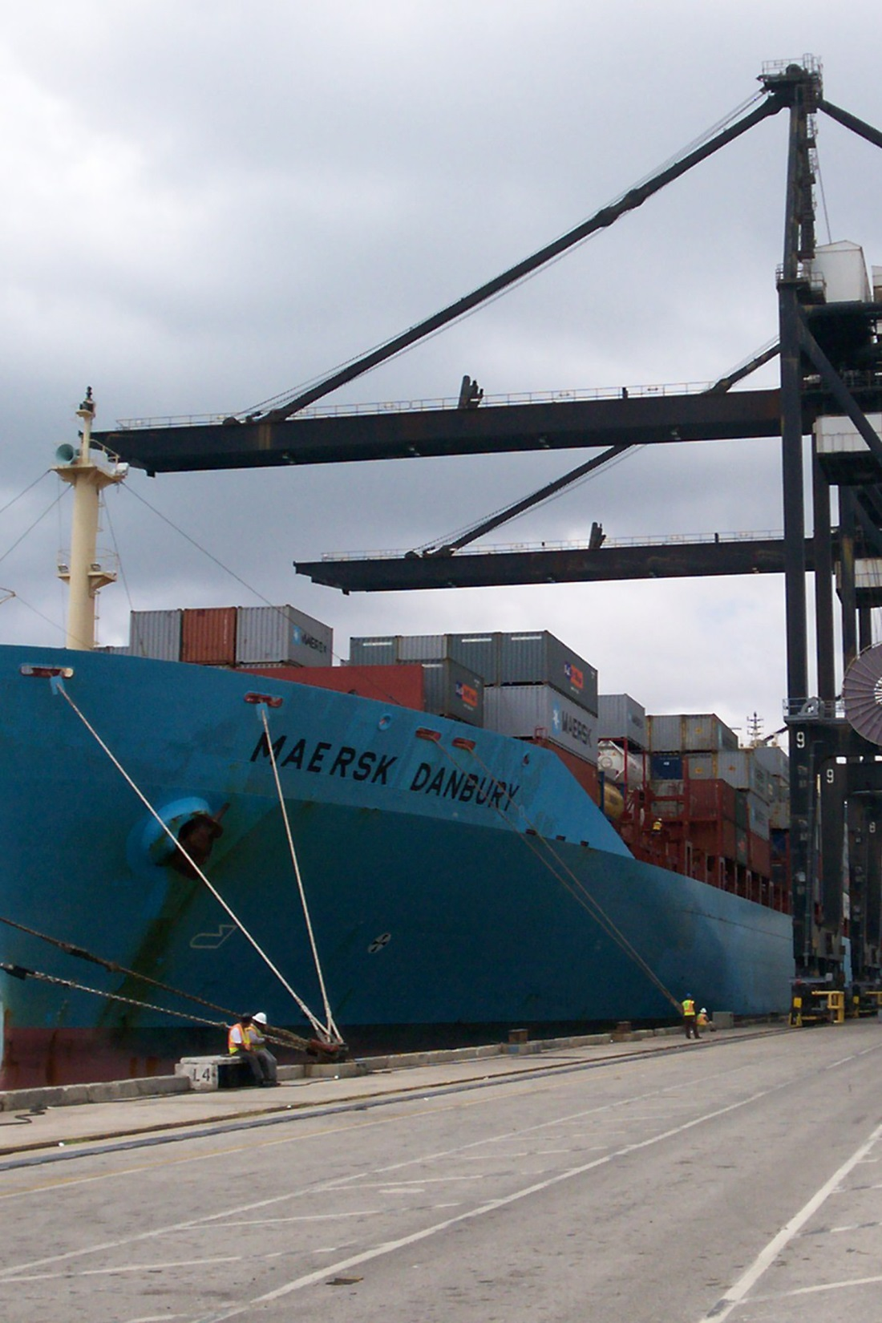
Potential impact
Entry potential
Host availability
Economic impact
Ecological impact
Photo: cargo ship at Miami port © Karen Snover-Clift, Cornell University
Notes:
USDA plant pathologists and other scientists have assessed the potential impacts that Scots pine blister rust could have on our commercial forest and natural ecosystems and have identified it as a serious threat. As you will soon see, early symptoms and signs of the disease are so subtle that the potential for introduction on plant material through international trade is very high.

Slide 6
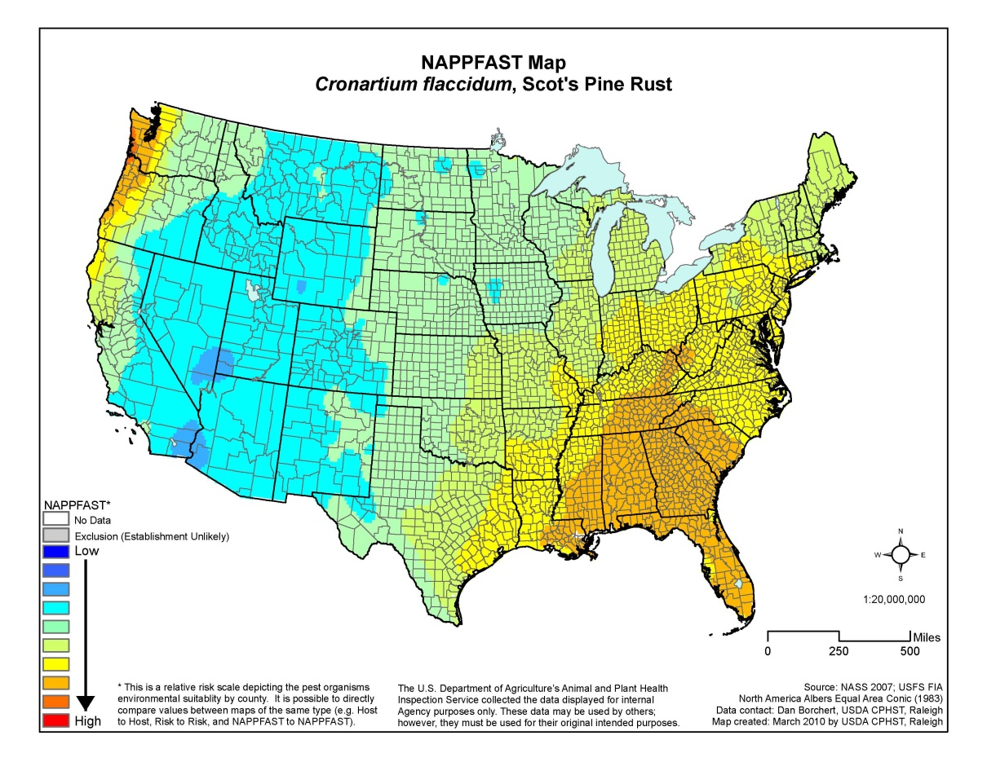
Potential impact
Entry potential
Host availability
Economic impact
Ecological impact
Map courtesy of https://caps.ceris.purdue.edu/
Notes:
In North America, there are many hard pine tree species which could be susceptible to Scots pine blister rust. If Scots pine blister rust were to be introduced into North America and only infect Eurasian host species, the disease would still significantly impact the nursery and Christmas tree industries.

Slide 7
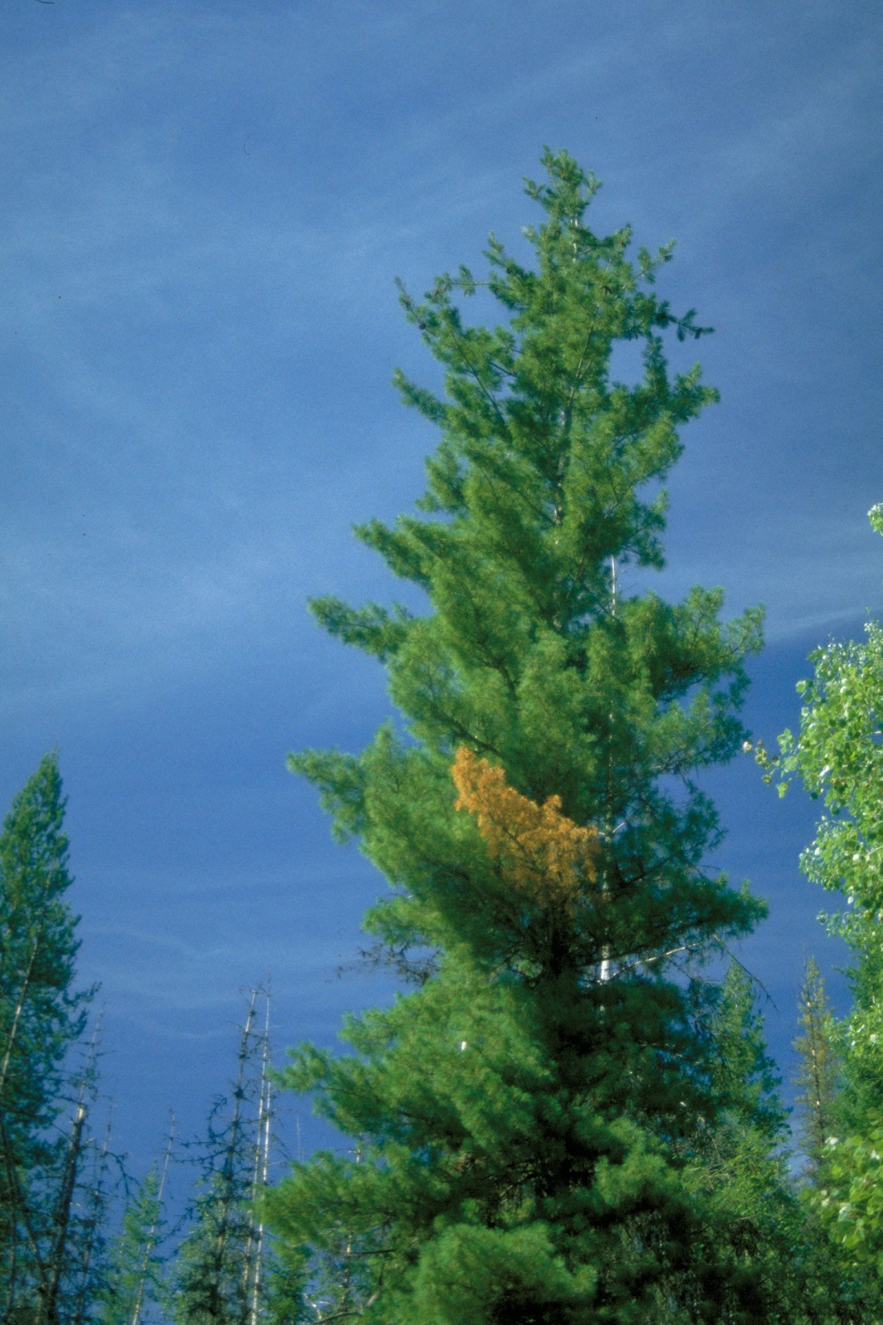
Potential impact
Entry potential
Host availability
Economic impact
Ecological impact
Photo: white pine blister rust on western white pine © Chris Schnepf, University of Idaho, Bugwood.org
Notes:
To give you some idea of what could be a stake in North America, consider the impact of white pine blister rust since it's introduction to the continent in the early 1900s. Five needled pines—the preferred hosts of that pathogen—have been severely impacted with timber losses alone estimated to be over $1 billion.
In addition to impacts on forest productivity, Scots pine blister rust would also likely damage trees planted for watershed stabilization and wildlife habitat; thus leading to increased erosion and decreased diversity of forest fauna.

Slide 8
Cronartium flaccidum biology
Fungal pathogen
  Rust pathogen
  Obligate parasite
  Complicated life cycle, alternating between pines and various flowering species (two hosts)
Interferes with normal tree growth by killing the cambium
Grows and survives as mycelium within the vascular system
Notes:
Scots pine blister rust is caused by Cronartium flaccidum, a fungus that grows in living bark of host trees. Rusts get their name from the rust colored spores that are produced on infected host plants. Typically, disease symptoms are most clearly recognized at the spore stage, when lesions with orange blisters form on specific parts of the plant.
For Scots pine blister rust, the most recognizable spore stage occurs on pine stems and branches. These lesions may spread around and along the stem, creating a canker which eventually kills the part of the tree above the lesion by blocking transport of sugars, water, growth hormones and other vital chemicals.
The pathogen survives as mycelium within the vascular system of host plants.

Slide 9
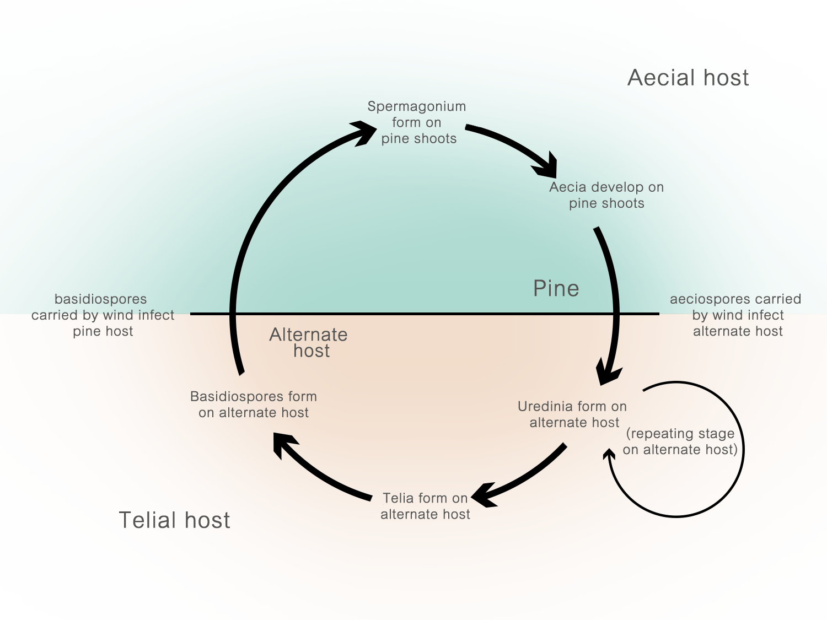
Approximate life cycle for
Cronartium flaccidum
Notes:
Rust fungi are highly specialized obligate biotrophs which means that they require a living host in order to complete their life cycle. They are uniquely complex in part because they typically have between three and five distinctly different spore stages. Each “stage” is morphologically different from the other stages of the same organism and the only way you would think to associate one with another is through published descriptions and personal experience.
Additionally, some rust pathogens require two unrelated hosts for completion of the cycle while others are able to complete the life cycle on one host species.

Slide 10
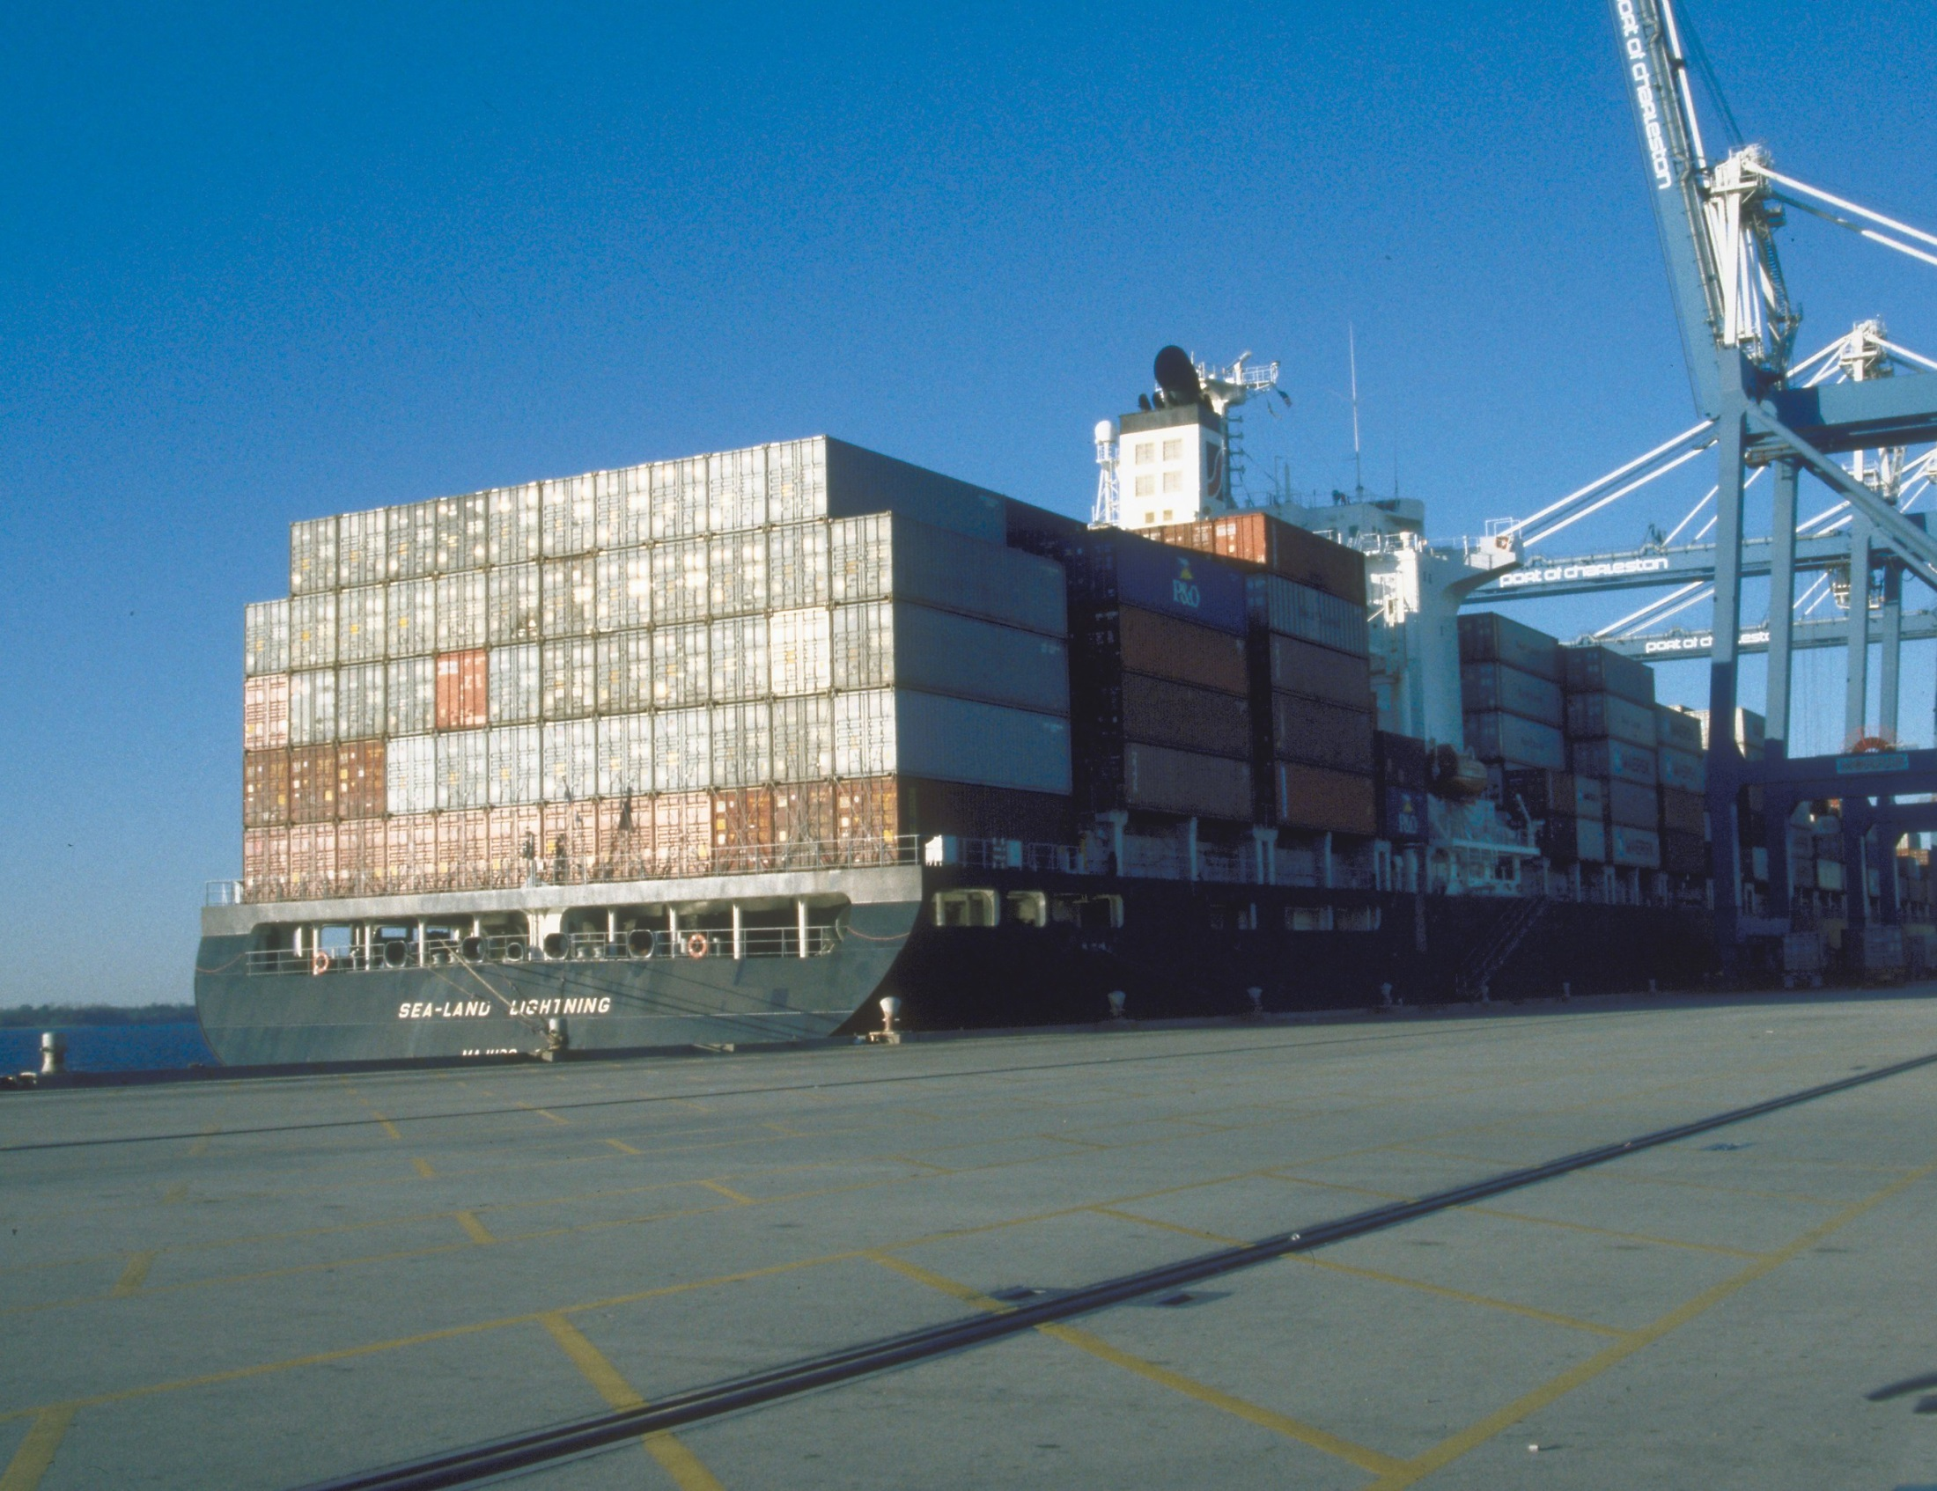
Introduction pathways
Photo: shipping containers waiting to be inspected © Larry R. Barber, US-FS, Bugwood.org
Notes:
To date, Scots pine blister rust has not been detected in the United States but the likely pathway for introduction would be on infected plant material, seedlings and nursery stock.
Japanese black pine (Pinus thunbergii), mugo pine (Pinus mugo) or other hard pines, commonly imported as live trees for use where dwarf conifers are desired for landscape design pose some of many significant threats for introduction of the pathogen.

Slide 11
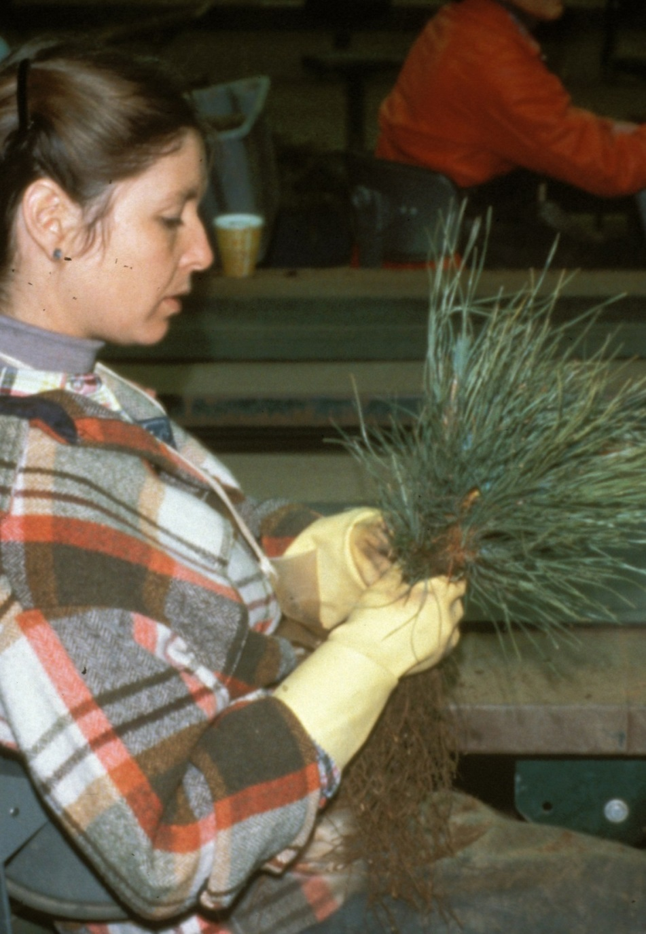
Introduction pathways
Exclusion is the first line of defense
Could be introduced unknowingly
Complicated if signs and symptoms are not visible at time of inspection
Photo: pine seedling inspection © Thomas D. 'Tom' Landis, USDA Forest Service, Bugwood.org
Notes:
Exclusion of the pathogen is the first line of defense but because the disease progresses slowly it could be missed on plants that are being inspected at ports of entry. Inspections are further complicated because signs and symptoms of this disease may be latent (inactive, hidden or dormant) for two or more years in infected pine host material and up to a month in leafy hosts.* For this reason especially, the pathogen may be unknowingly introduced.

Slide 12
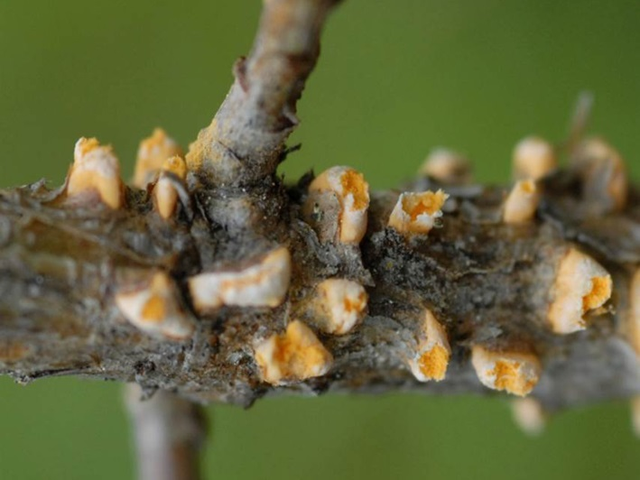
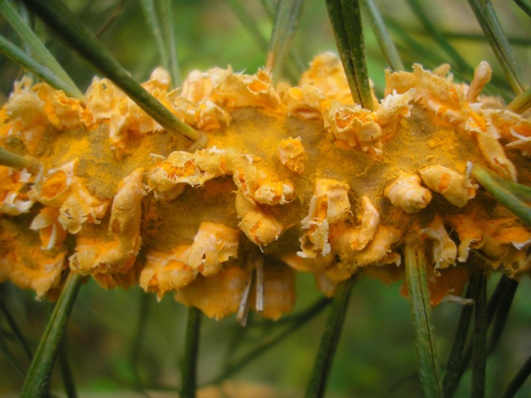
Spread potential—natural dispersal
Photos: aesciospores (top) © Hansson, Swedish Univ. of Agricultural Sciences and
(bottom) © Julia Kruse, Biodiversity and Climate Research Centre
Wind carries spores to new hosts
Fungal spores infect new plants
Notes:
If the pathogen were to be introduced and go unnoticed it could easily spread. In general, rust spores are distributed by wind. Typically, spores are hardy and can be carried great distances to infect new host plants. One spore stage is delicate so distribution is limited and typically requires moisture or humidity to infect new hosts.

Slide 13
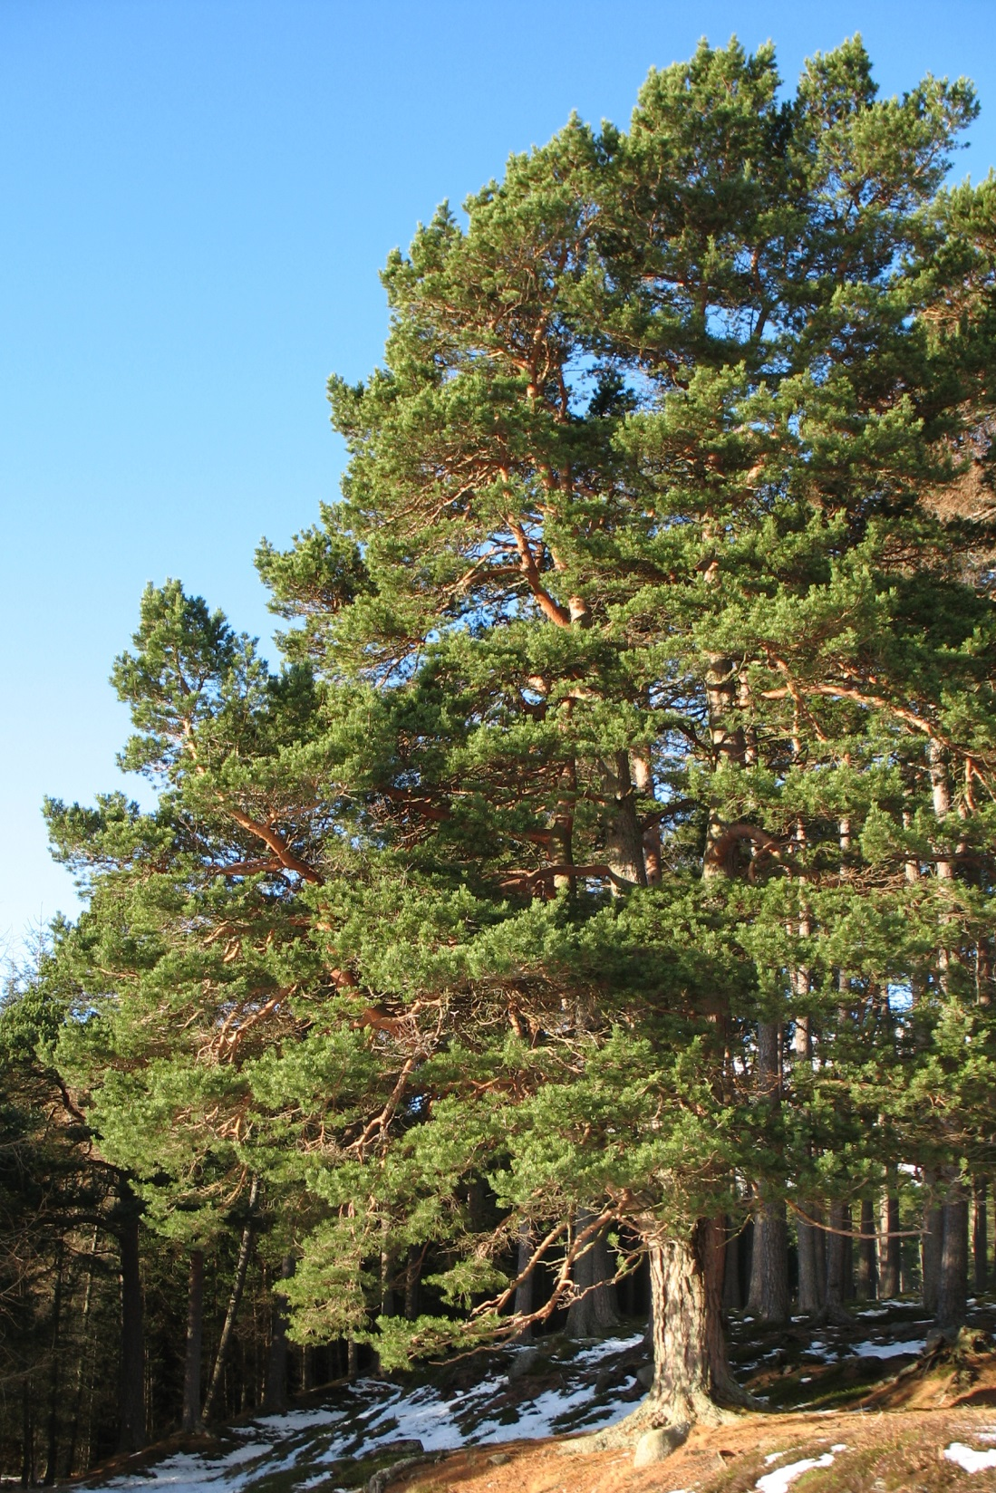
Hosts
Two needle pines
Scots pine (Pinus sylvestris) (common host in northern Europe)
  Introduced to North America
  Important to several industries and widely planted, as well as naturalized in some areas
  Christmas Trees
  Timber
  Pulp
Susceptibility to North American pines is unknown
Photo: Pinus sylvestris © Bruce McAdam, flickr via wikimedia commons
Notes:
Cronatrium flaccidum infects many pine species in Europe and Asia. It has been reported mainly on two needle pines but three needle pines have been reported as hosts.* In northern Europe Scots pine is a common host but the pathogen has been reported affecting Mediterranean pine species in forests in southern Europe. Susceptibility on Asian pine hosts requires further attention.
Scots pine is the most widely distributed pine in the world. In the United States it has been widely planted and has naturalized in many areas particularly in the northeast and Great Lakes regions. It is planted for erosion control, pulp wood, timber and Christmas trees.

Slide 14
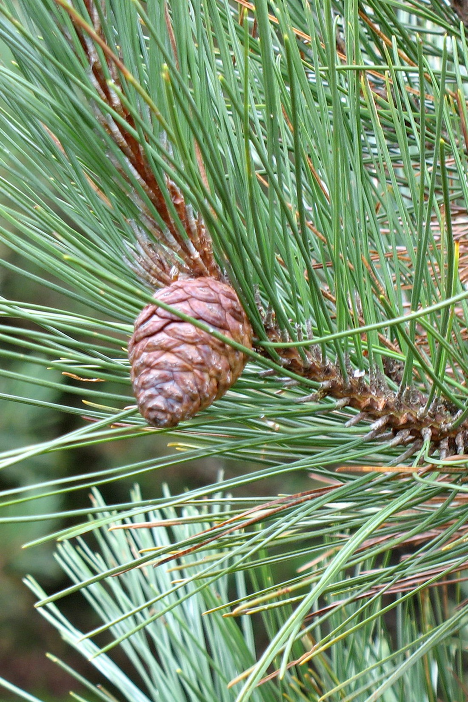
Reported hosts
Pinus halepensis,* aleppo pine
Pinus mugo, mugo pine
Pinus nigra, Austrian pine
Pinus pinaster, maritime pine
Pinus pinea, stone pine
Pinus resinosa, red pine (potential host)
* typically two needles, may have three needles per fascicle
** five needles per fascicle
Photo: red pine cone, wikimedia commons
Notes:
Cronartium flaccidum is known to infect other two needle pines with different levels of susceptibility. There are reports of the disease on over 15 pine species. Public gardens with exotic pine collections may have more hosts.
The disease has also been recorded on mugo pine, dwarf mountain pine, ponderosa pine and black pine. There is some indication that P. resinosa (red pine) can act as a host. (Raddi and Fagnani, 1978)
Not much is known about the susceptibility of North American species. If the pathogen were to be introduced it could gain or have the capacity to infect native pine species which may not be known hosts in Europe and Asia.
* typically two needles, may have three needles per fascicle

Slide 15
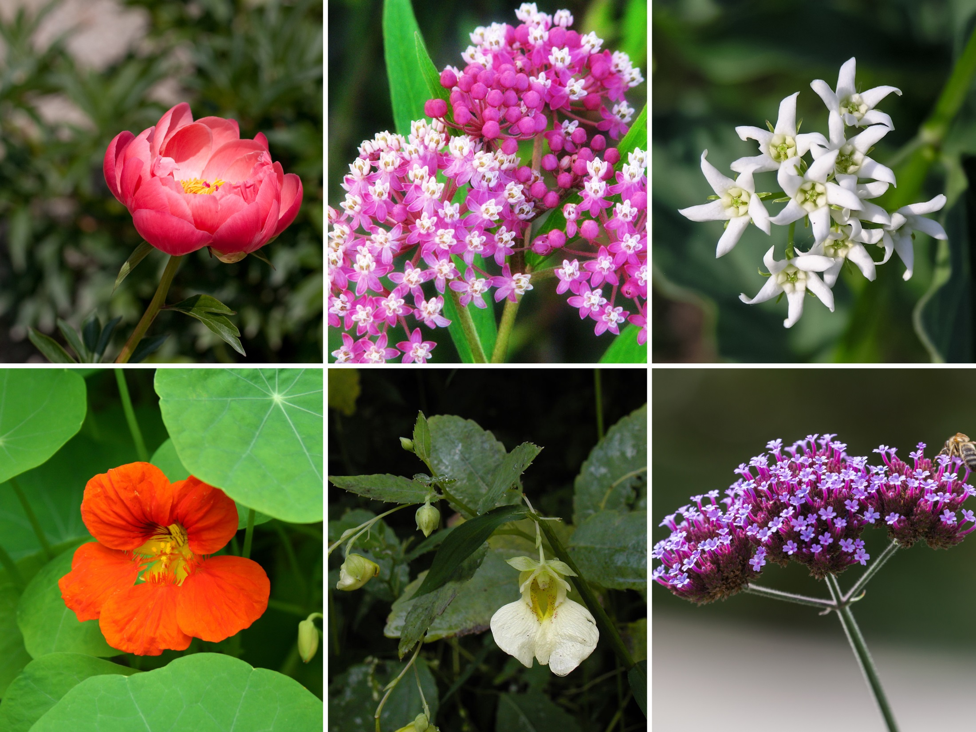
Alternate hosts
Photos © wikimedia commons
Paeonia spp.
Asclepias spp.
Vincetoxicum spp.
Tropaelum spp.
Impatiens spp.
Verbena spp.
Notes:
If you think detecting Scots pine blister rust on pines is tricky, consider the enormous challenge posed by finding the pathogen on its many alternate hosts. Although we don't know for sure how broad that host range may be in North America, occurrence of the pathogen on such diverse plants as Paeonia, Asclepia, Delphinium and Impatiens complicate detection efforts considerably.

Slide 16
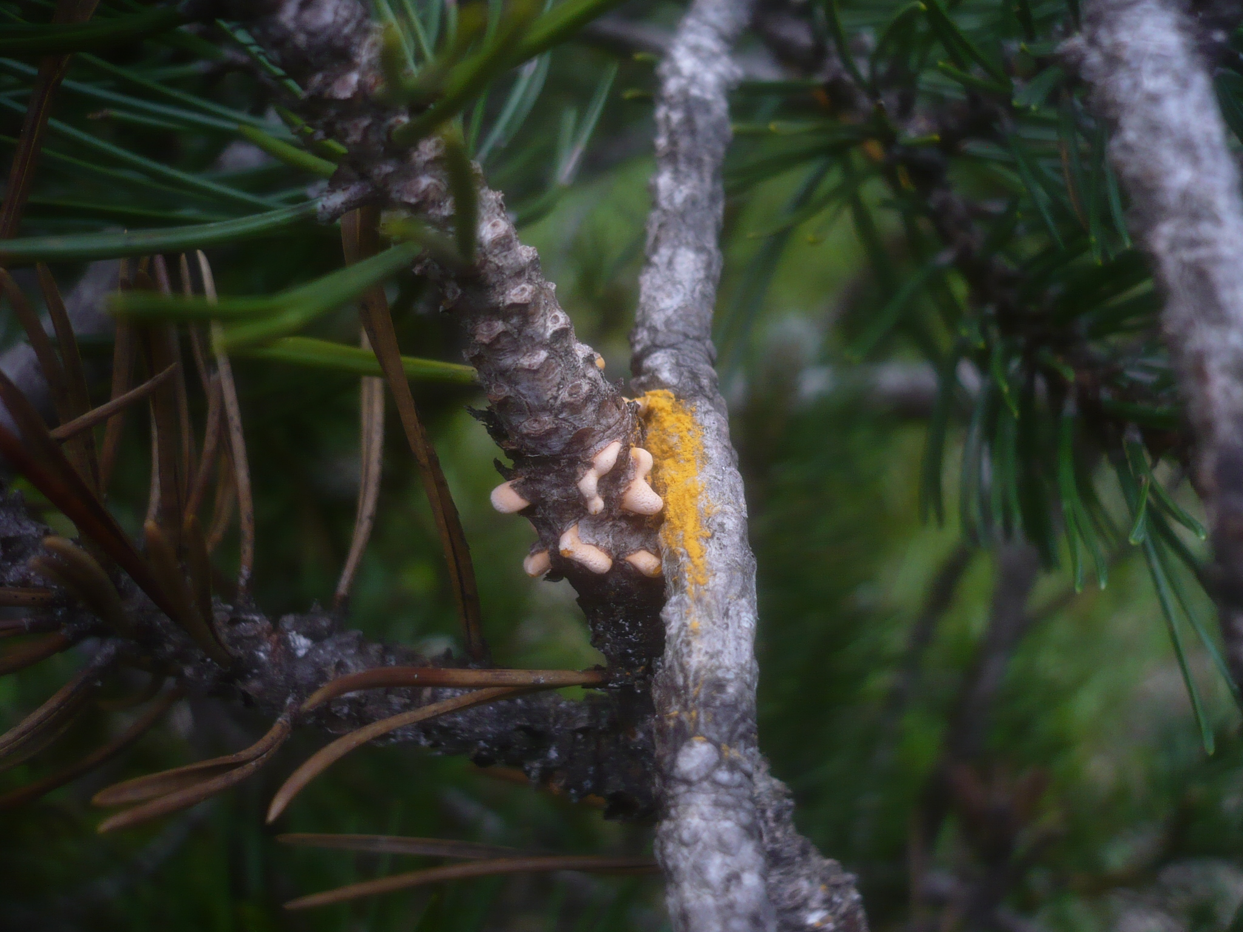
Symptoms and signs
Photo: Cronartium flaccidum on mugo pine © Gerhard Koller, the mushroom observer
Notes:
Some rust diseases are identifiable based on the symptoms they cause (ie. pine-pine gall rust, yellow witches'-broom) while some are identifiable by the host they infect (white pine blister rust, scots pine blister rust).
Still for most, you must actually see “signs” of the pathogen and where they are occurring on the plant to make a positive ID of the disease or pathogen.

Slide 17
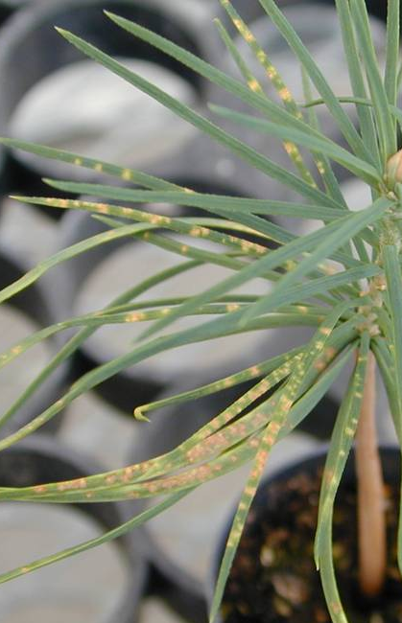
Symptoms
Needle symptoms on white pine caused by white pine blister rust
On pine:
Spots on needles (or not)
Stem swelling/cankers
Branch flagging
Excessive pitch flow
Top-kill
© US-FS, via high elevation white pines
Notes:
On pines, Scots pine blister rust can cause a range of symptoms including spots on needles, stem swelling, branch flagging, excessive pitch flow and top-kill. Infection occurs through the needles and the earliest potential visual symptom would be the presence of yellow spots on the needles. Sometimes infected trees will not produce this symptom and because this disease is slow to progress symptoms on needles will surely go unnoticed anyway. This is a picture of similar needle symptoms on a white pine seedling infected with white pine blister rust.

Slide 18
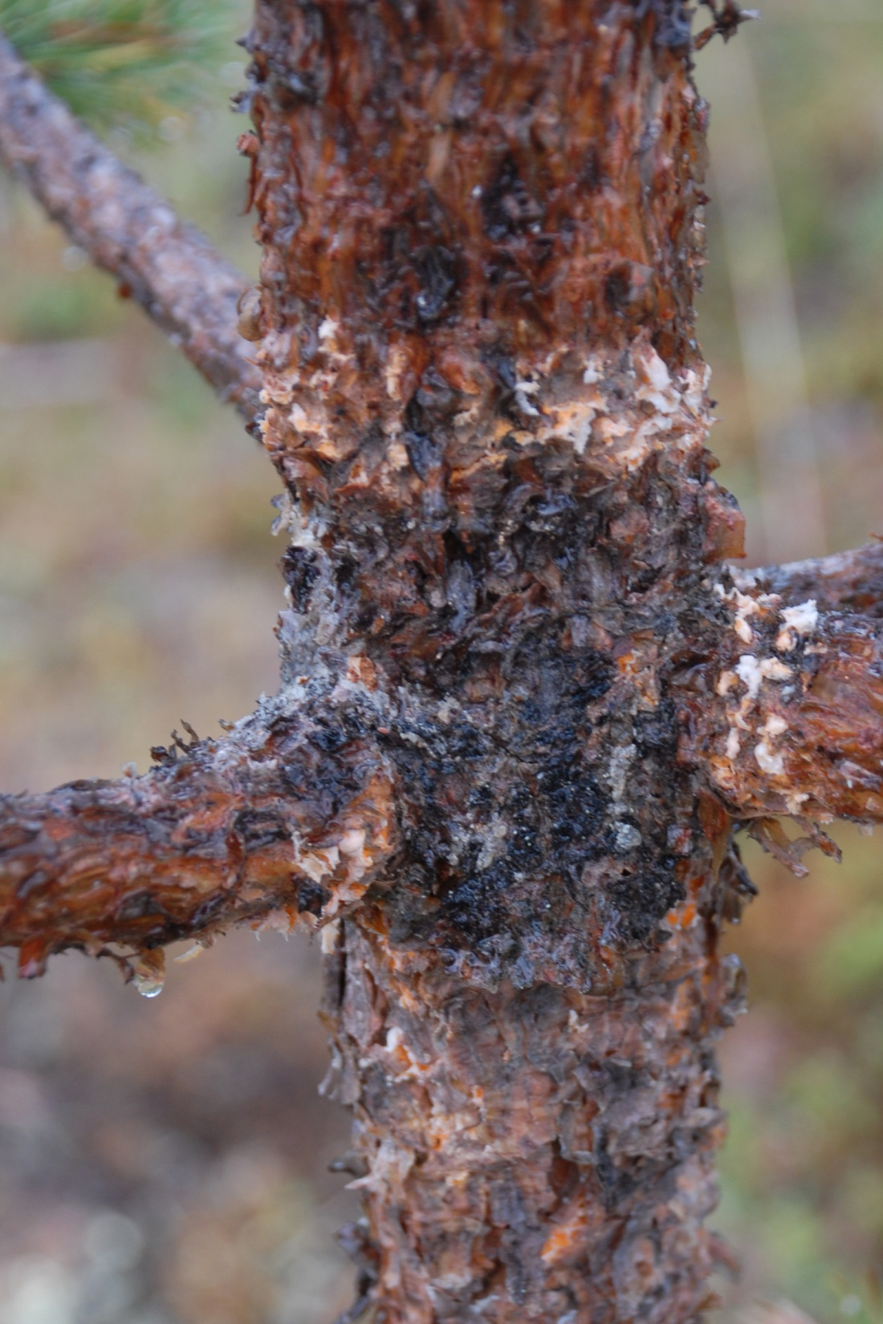
Symptoms
On pine:
Spots on needles (or not)
Stem swelling/cankers
Branch flagging
Excessive pitch flow
Top-kill
© US-FS, via high elevation white pines
Photo: canker on trunk © Hansson, Swedish University of Agricultural Sciences
Notes:
On main stems or large diameter branches (> 5cm), the disease may first appear as a diamond-shaped canker that exudes a lot of resin. Main stem cankers typically girdle the tree at the infection site, leaving the top to die. This is where the common name resin-top disease is derived. Branch dieback progresses downward as the fungus grows into new live tissues on the stem and attached branches, killing them as it grows.

Slide 19
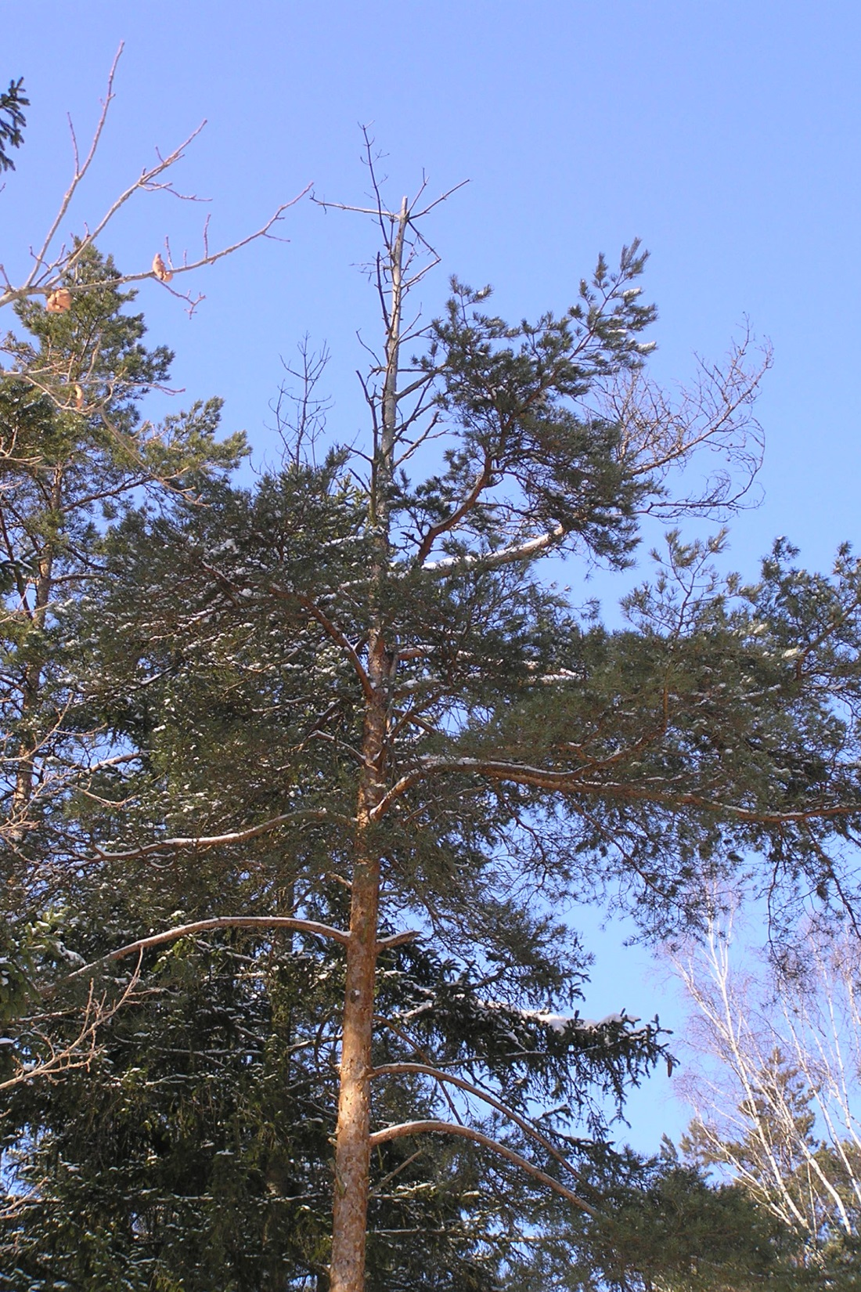
Symptoms
On pine:
Spots on needles (or not)
Stem swelling/cankers
Branch flagging
Excessive pitch flow
Top-kill
Photo: top kill on Scots pine caused by SPBR © wikimedia commons, beentree
Notes:
Sometimes, dieback of individual branches precedes top kill. The resulting symptom is called "flagging" but flagging isn't diagnostic in and of itself inasmuch as many other pests and pathogens also cause individual branches to die.

Slide 20
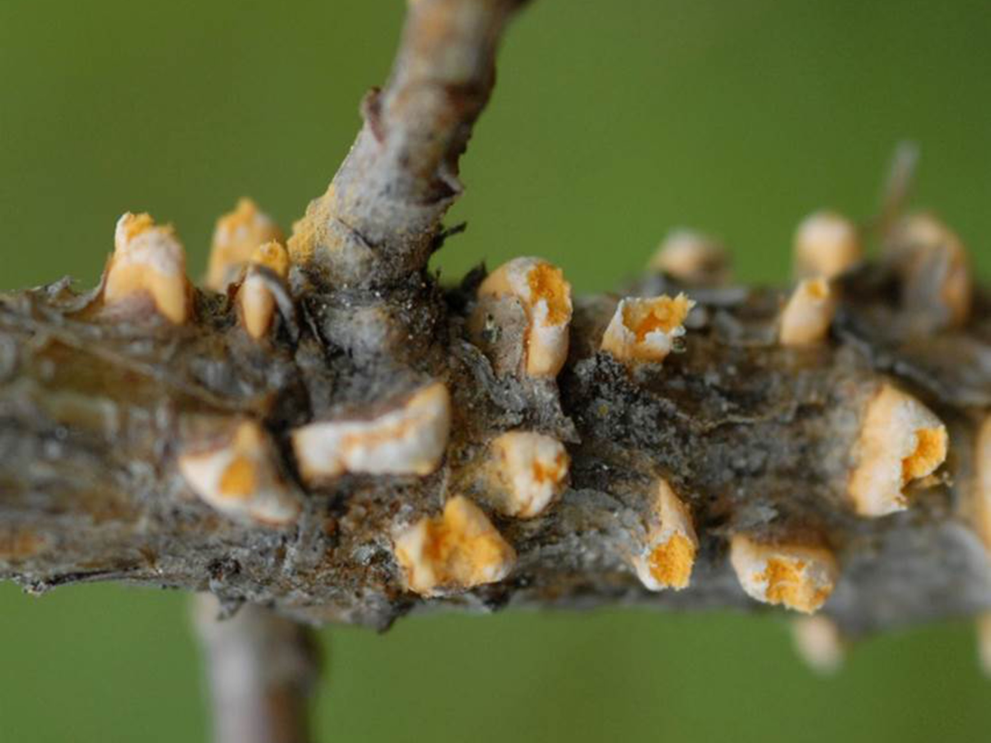
Signs
© Per Hansson, Swedish University of Agricultural Sciences
Notes:
Several years after initial infection, C. flaccidum produces spores in conspicuous "blisters" on infected bark. The blisters are visible for about a month and during this time, diagnosis of the disease is relatively easy. This will continue annually until the tree is completely dead.

Slide 21
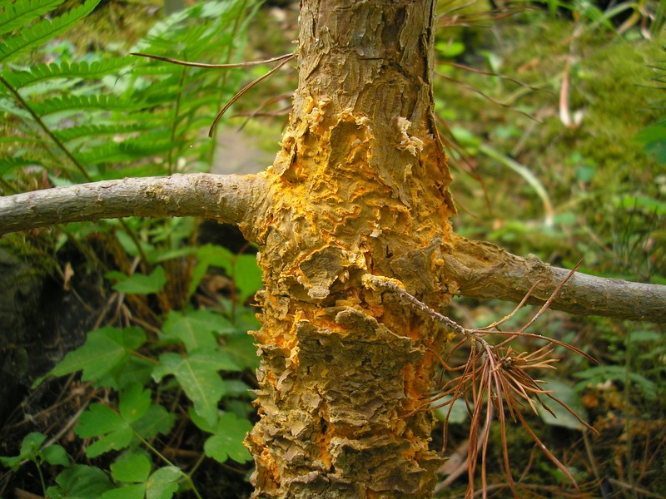
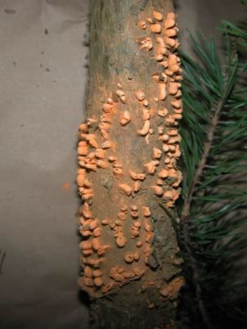

Signs
© CAPS (left) and J. Kruse photos right
Notes:
Of course, as is the case with anything from the real world, no two cankers or sporulating bark sections are going to look exactly alike. Shown here are a few of the thousands of possibilities.
Remember the complex biology from earlier? The spores produced in the pine blisters cannot infect other pines. Instead, they must be blown to nearby alternate host plants; herbaceous plants such as peonies, impatiens, etc. There the spores infect the leaves and cause completely different (from appearance on pine) symptoms and signs.

Slide 22
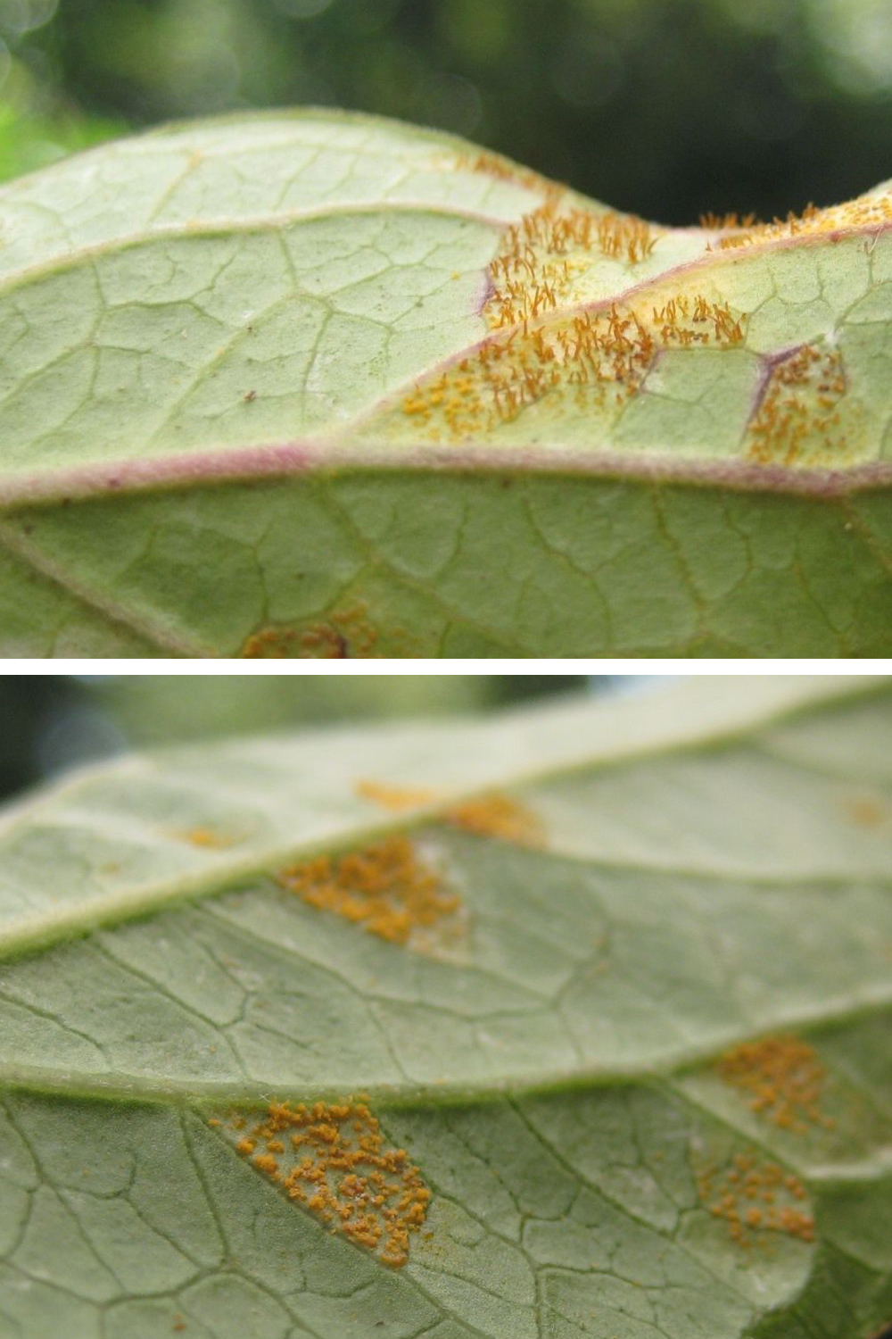
Alternate host signs
Three spore stages occur on alternate hosts
Underside of leaves
One spore stage is a repeating or cycling stage that reinfects alternate hosts
© Hans Henrik Bruun, University of Copenhagen
Notes:
First to appear are yellow leaf spots—which are symptoms. A few days to weeks later, yellow-orange powdery masses of spores appear on the undersides of the spotted leaves—signs. These spores can infect more alternate host leaves and this infection and reinfection cycle will continue for most of the growing season.
As autumn approaches, the powdery spore masses will be replaced with hair-like masses characteristic of a second spore stage. Sometimes, the "hairs" are so prolific that untrained eyes will presume that they are natural leaf hairs. Not so! Within a week or two of appearance of these spore columns, a microscopic third spore stage is produced.
The third spore stage is the one that is blown back to pine to infect new needles and the fungus settles in for the winter.

Slide 23
Peridermium pini
(Endocronartium pini)
Closely related rust pathogen
  Only requires pine host to complete its life cycle
  Could spread more readily with only one host
Genetically identical
Same symptoms on pine
Same signs on pine
Notes:
As if the complex lifestyle of Cronartium flaccidum isn't enough to send your head spinning, one can't complete this story without adding yet another complication. There is another fungus, nearly identical in every way to C. flaccidum, that causes the same symptoms and signs on pines but that doesn't have an alternate host. That fungus—Peridermium pini—produces yellow-orange spores on pine bark but the spores can go immediately to new pine needles to cause new infections.
Both fungi are serious threats to tree health and there is no way that you can tell them apart on pines in the field.

Slide 24
What you should do…
Do not import live host plants from Europe or Asia which are potential hosts for Scots pine blister rust.
  Isolate new host plants for 4–5 years.
Monitor two needle and three needle pines in botanical collections and natural areas for Scots pine blister rust.
Monitor alternate hosts for symptoms and signs of rust diseases.
Familiarize yourself with any native and introduced rust diseases in your area.
Notes:
Do not import live host plants from Europe or Asia which are potential hosts for Scots pine blister rust. If this cannot be avoided, isolate new plants from other plants for 4–5 years.
Monitor two needle and three needle pines in botanical collections and natural areas for Scots pine blister rust.
Monitor alternate hosts for symptoms and signs of rust.
Familiarize yourself with any native and introduced rust diseases in your area.

Slide 25
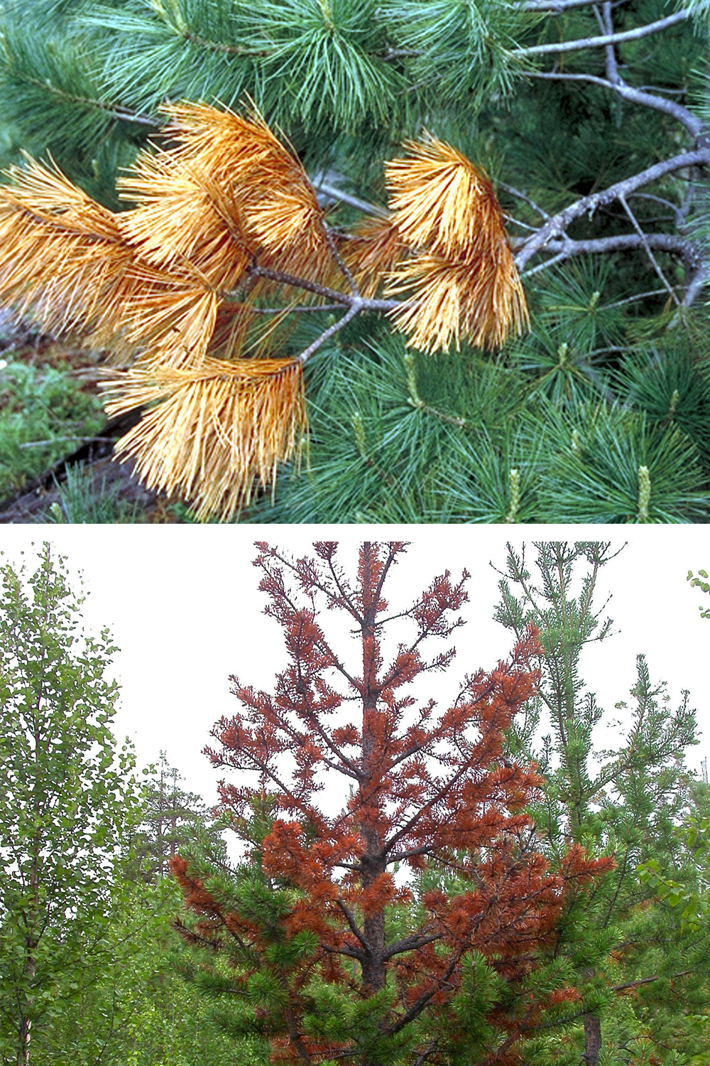
Scouting
Flagging
Look for flagging, top-kill and excessive pitch flow
In symptomatic pines look for visual signs of the pathogen
Answer these questions to help determine if the infected pine could have Scots pine blister rust
  Who (what species) is affected?
  What are the symptoms?
  Where on the pine are the signs visible?
Photo: flagging symptom on white pine caused by white pine blister rust © John W. Schwandt, US-FS, Bugwood.org
Top-kill
Photo: top-kill symptom © Hansson, Swedish University of Agricultural Sciences
Notes:
Tree health care professionals recommend that two needle pines—especially those originating in Europe—be monitored for signs of the pathogen every spring when the spore blisters are most conspicuous. Look for fruiting bodies on stems and bark of pine hosts and leaves of alternate host plants. Any trees with flagging, resinous cankers, or top dieback should be examined extra carefully, three times at bi-weekly intervals starting when new growth begins.
Answer these questions to help determine if the symptomatic pine could have Scots pine blister rust:
Who (what) species is/are affected?
What are the symptoms?
Where on the pine are the signs visible?
Who refers to which pine host? Soft pines or five needle pines are not susceptible to Scots pine blister rust. Similar symptoms on a five needle pine could be eliminated.

Slide 26
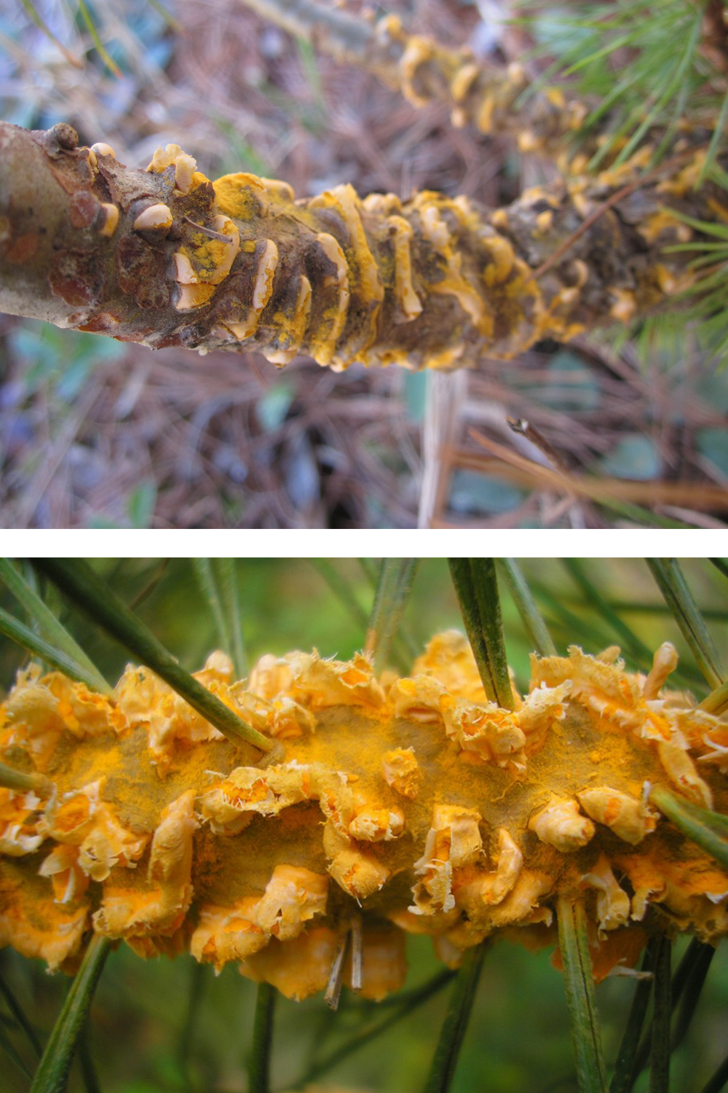
Scouting
White pine
What species is/are affected?
What are the symptoms?
Where on the pine are the signs visible?
Photo: spores on white pine (five needle pine)© Dawn Dailey O’Brien, Cornell University
Scots pine
Photo: spores on Scots pine (two needle pine) © J. Kruse, Biodiversity and Climate Research Centre

Slide 27
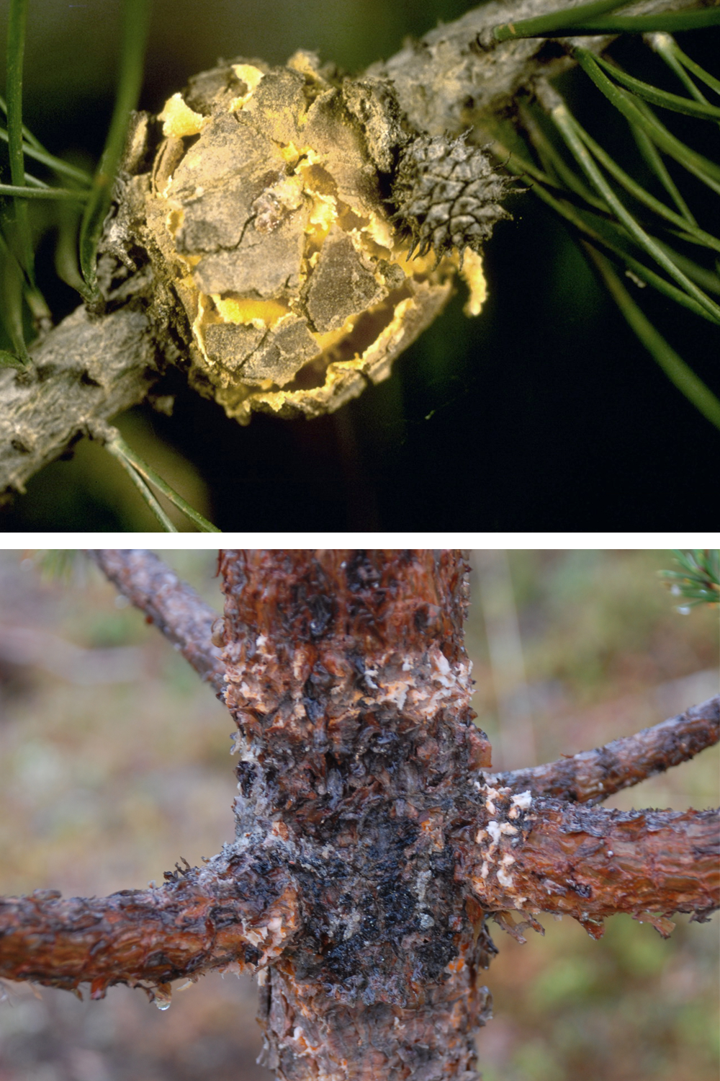
Scouting
Gall
What species is/are affected?
What are the symptoms?
Where on the pine are the signs visible?
Photo: gall symptom © James W. Byler, US-FS, Bugwood.org
Canker
Photo: canker symptom © Hansson, Swedish University of Agricultural Sciences
Notes:
What are the symptoms? Are the symptoms the same as those described in this presentation?
Are galls present? Some rust pathogens produce galls but not Scots pine blister rust.
Branch swelling, flagging, copious resin, etc. would be reason to look more closely.

Slide 28
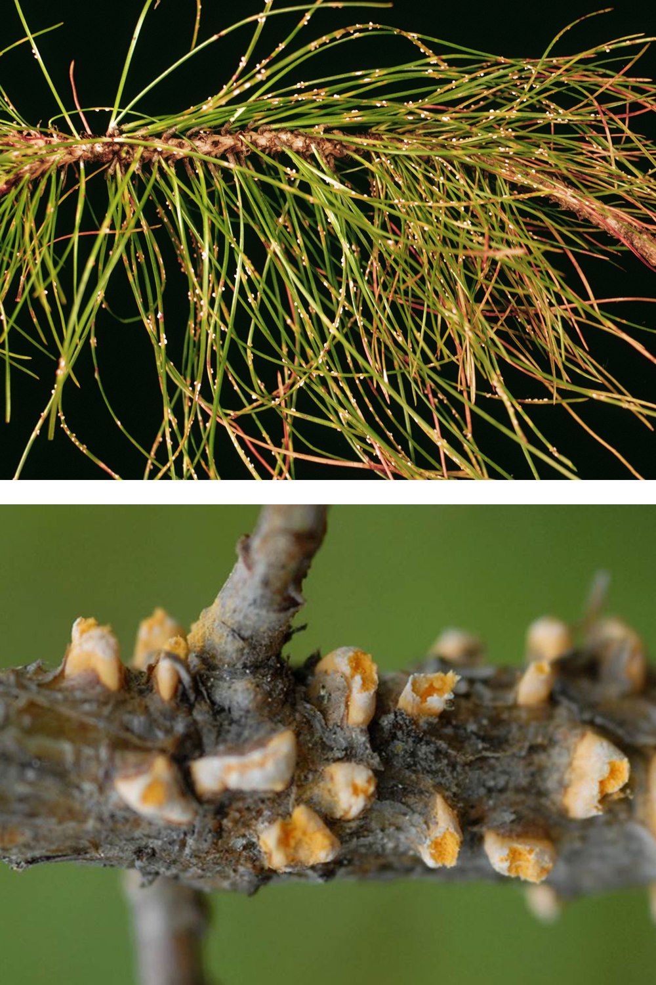
Scouting
On needles
What species is/are affected?
What are the symptoms?
Where on the pine are the signs visible?
Photo: pine needle rust © US-FS North Central Research Station Archive, USDA-FS, Bugwood.org
On stem
Photo: Scots pine blister rust © Hansson, Swedish University of Agricultural Sciences
Notes:
Where on the pine are the signs visible? Scots pine blister rust is a stem rust that means that the signs will be visible on the stems and branches. Some other rusts only affect needles or cones.

Slide 29
Contact your state NPDN lab…
If you think you have found Scots pine blister rust contact the NPDN diagnostician in your state.
Take a series of quality photographs and send them to the diagnostician then ask about sending in a physical sample.

Slide 30
Send in a proper sample…
Remember when sending samples that are considered to be significant or high-consequence these tips…
  Collect 6 to 8 inches of plant material with symptoms, wrap it in paper towels or newspaper, and bag it.
  Best if you can get the whole plant, but that may not be feasible.
  Collect 6 to 8 inches of plant material without symptoms, wrap it in paper towels or newspaper, and bag it separately.
  Put both these samples plus the sample submission form in yet another bag.
Review NPDN’s sample submission module and contact your state diagnostician with any questions.
Notes:
Review NPDN’s sample submission module and contact your state diagnostician if you have sample collecting or packaging questions.

Slide 31
References
"Cronartium flaccidum (Scots Pine Blister Rust)." Invasive Species Compendium. CABI, n.d. <http://www.cabi.org/isc/datasheet/16148>.
"Pinus Sylvestris." Index of Species Information. U.S. Forest Service, n.d. <http://www.fs.fed.us/database/feis/plants/tree/pinsyl/all.html#DISTRIBUTION%20AND%20OCCURRENCE>.
Geils, B.W., Klopfenstein, N.B., Kim, M.-S., Spaine, P., Richardson, B.A., Zambino, P.J., Shaw, C.G., Walla, J., Bulluck, R., Redmond, L., and Smith, K. 2009. Recovery plan for Scots pine blister rust caused by Cronartium flaccidum (Alb. & Schwein.) G. Winter and Peridermium pini (Pers.) Lev. [syn. C. asclepiadeum (Willd.) Fr., Endocronartium pini (Pers.) Y. Hiratsuka]. <http://www.fs.fed.us/rm/pubs_other/rmrs_2009_geils_b001.pdf>

Slide 32
References
Kaitera et al, 2012. “Alternate host ranges of Cronartium flaccidum and Cronartium ribicola in northern Europe.” Botany, 90 (8): 694-703
Kaitera and Hiltunen, 2012. “New alternate hosts for the rusts Cronartium ribicola and Cronartium flaccidum in Finland.” Can. J. For. Res. 42: 1661-1668
Kolmer, James A; Ordonez, Maria E; and, Groth, James V (September 2009) The Rust Fungi. In: Encyclopedia of Life Sciences (ELS). John Wiley & Sons, Ltd: Chichester.
Sullivan, M. 2010. CPHST Pest Datasheet for Cronartium flaccidum. USDA-APHISPPQ-CPHST.

Slide 33
Questions
on this module or the NPDN contact Rachel McCarthy at rachel.mccarthy@cornell.edu
on how to collect or submit a sample contact your state NPDN diagnostician at www.npdn.org

Slide 34
Author credits
Rachel McCarthy, Plant Pathology and Plant-Microbe Biology Section, School of Integrative Plant Science, Cornell University
George Hudler, Plant Pathology and Plant-Microbe Biology Section, School of Integrative Plant Science, Cornell University

Slide 35
Reviewer credits
Dawn Dailey O’Brien, Plant Pathology and Plant-Microbe Biology Section, School of Integrative Plant Science, Cornell University

Slide 36
Date of Publication
February 2015

Slide 37
Publication details
This publication can be used for non-profit, educational use only purposes. Photographers retain copyright to photographs or other images contained in this publication as cited. Authors and the website should be properly cited. Images or photographs should also be properly cited and credited to the original source.

Slide 38

The Sentinel Plant Network
The Sentinel Plant Network (SPN) is a collaboration between the American Public Gardens Association (APGA) and the National Plant Diagnostic Network (NPDN) and is funded through the USDA’s Animal and Plant Health Inspection Service (APHIS).
Notes:
We believe that the never ending battle to slow or stop exotic pest and pathogen introductions can best be waged by the combined efforts of two organizations with similar goals.
The partnership, dubbed the Sentinel Plant Network is a cooperative project between the American Public Gardens Association (APGA) and the National Plant Diagnostic Network (NPDN) with funds for cementing the union coming from USDA-APHIS.
The Sentinel Plant Network is expected to enhance diagnostic capabilities via improved communication between public gardens and expert diagnostic facilities with access to advanced technologies.

Slide 39
The Sentinel Plant Network’s Mission
The Sentinel Plant Network contributes to plant conservation by engaging public garden professionals, volunteers and visitors in the detection and diagnosis of high-consequence pests and pathogens.
For more information on the Sentinel Plant Network visit www.sentinelplantnetwork.org

