Slide 1
Oak Splendor Beetle
Sentinel Plant Network Pest/Pathogen Series
Notes:
This presentation will introduce you to the oak splendor beetle, Agrilus biguttatus, a pest not known to be in the United States that poses a serious risk to US urban and forest ecosystems should it be introduced. USDA has been and continues to survey for this pest but we ask that members of the Sentinel Plant Network keep their eyes out for it as well. Monitoring for the oak splendor beetle is difficult because damage symptoms develop slowly and look like those caused by other native borers, drought or stress.
The text provided in the notes section is not meant to be read verbatim to the audience. It is meant to provide the speaker with the necessary background information to support what is presented on each slide.

Slide 2
Agrilus biguttatus, oak splendor beetle
Synonyms include: Agrilus pannonicus, Buprestis biguttatus, A. subfasciatus, A. morosus. Other common names: two-spotted oak borer, two-spotted wood borer
© Kent Loeffler, Cornell University
Notes:
Agrilus biguttatus is a relative of the emerald ash borer, an invasive insect pest responsible for the death of millions of ash trees in the US.
Detection of A. biguttatus is significantly more complex than detection of emerald ash borer, Agrilus planipennis. In the case of emerald ash borer, there are no native species of Agrilus that attack ash in North America, therefore, the presence of signs and symptoms are a clear indication of an EAB infestation. We will see that this is not the case with oaks…

Slide 3
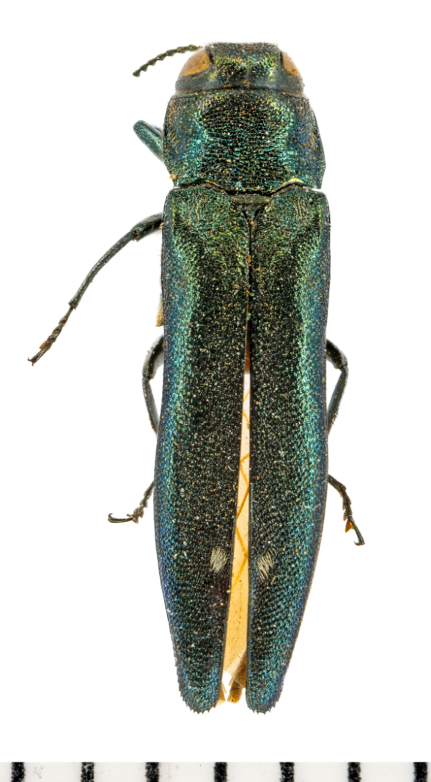
Agrilus biguttatus
Background
Impact
Pathways
Insect biology and identification
Photo: © Kent Loeffler, Cornell University
Notes:
This presentation will provide you with a better understanding of Agrilus biguttatus, the oak splendor beetle, its potential impact should it be introduced to the US, and the likely pathways for its introduction and spread.

Slide 4
Agrilus biguttatus, cont…
Hosts
Signs and symptoms
Scouting
What to do if you suspect you find it
Submitting samples
Photo: © Kent Loeffler, Cornell University
Notes:
Additionally you will learn how to recognize signs and symptoms caused by this and similar pests and what to do if you suspect an infestation.

Slide 5
Background
Agrilus biguttatus is a buprestid wood boring beetle. Adult buprestid beetles are called jewel beetles.
The larvae feed in the cambial layer which girdles trees. Buprestid larvae may be referred to as flatheaded borers.
Photo: © Milan Zubrik, Forest Research Institute - Slovakia, Bugwood.org
Notes:
Like the emerald ash borer, the oak splendor beetle is a metallic wood boring beetle in the family buprestidae. Like other buprestid beetles, the larvae feed in the cambial layer of trees which in time girdles the tree. This species feeds on weakened or stressed trees and is considered a “very aggressive secondary organism”. Trees may die as a result of attack from Agrilus biguttatus before they are able to recover from other stresses.

Slide 6
Photo: © Louis-Michel Nageleisen, Département de la Santé des Forêts, Bugwood.org
Notes:
Agrilus biguttatus is native to Eurasia, including most of Europe, northern Africa, portions of the Near East and Russia as far east as Siberia.
In several countries in Europe it has become a significant component of oak decline or oak dieback.
In Germany attack by A. biguttatus was reported to be the cause for extensive tree mortality after trees were defoliated by gypsy moth.

Slide 7
Potential impact
Ecological impact – high
Economic impact – high
Environmental – high
Host availability – medium/high
Entry potential – low
Establishment potential – high
Photo: © Kent Loeffler, Cornell University
Notes:
The USDA-APHIS conducts risk assessments on imminent insect and disease threats. A score is given that rates how big of a risk a pest or disease poses to our country.
Based on the USDA assessment of these and other categories, the overall, potential impact of Agrilus biguttatus within an infested area scored HIGH.

Slide 8
Potential Ecological Suitability
High
Potential distribution are highlighted in green
68% of the continental US has a suitable habitat/climate
Source: CAPS PRA A. biguttatus, mini risk assessment
Notes:
To determine the potential distribution of a quarantine pest in the US, USDA considers the worldwide geographic distribution of the species and identifies the biomes where the species is established.
Within its native range, Agrilus biguttatus occurs in climates that are warm and dry to temperate with rainfall enough to support forest trees. This map was constructed during the initial risk assessment and illustrates where this pest is most likely to encounter a suitable climate and host range for establishment.

Slide 9
Potential Economic Impact
High
Timber losses
Forestry product industries at risk
Domestic and/or international quarantines may impact trade
Photo: © Stephen Bratkovich, USDA Forest Service, Bugwood.org
Notes:
In much of Europe Agrilus biguttatus is an important pest of oak. Significant tree mortality and oak decline can be attributed to this pest in Belgium, Germany, Hungary and Poland. Almost 50,000 acres of oak were lost to this pest in Voronezh, Russia.
Oak is without doubt one of the most important woody genera of the Northern Hemisphere. Historically, oaks have been an important source of fuel, fodder, and building materials throughout their range. As a timber resource, damage of old trees causes high financial losses because of its long rotation time.
Establishment of this pest in the US would have tremendous impact on domestic and international trade which would impact many US commodities.

Slide 10
Potential Environmental Impact
Trees defoliated by gypsy moth would be more vulnerable to attack by a secondary organism like the oak splendor beetle.
High
Reduce biodiversity
Disrupt ecosystem function
Degrade critical habitat
Endanger threatened plants
Increase use of chemical or biological control
Photo: © Bill McNee, Wisconsin Dept of Natural Resources, Bugwood.org
Notes:
Forest damage, defoliation and mortality have significant impacts on both the environment and ecosystem health. When assessing environmental impact such things as effects on biodiversity and disruption of overall ecosystem function are considered.
The oak splendor beetle prefers weakened and stressed trees, but is considered a very aggressive secondary invader. In countries battling this pest, mortality rate has been high when stressed trees were attacked by this pest.
In forests already under stress by defoliators or drought, establishment of the oak splendor beetle could cause extensive tree mortality which could alter the composition of many eastern oak-hickory forests in favor of non-host species.

Slide 11
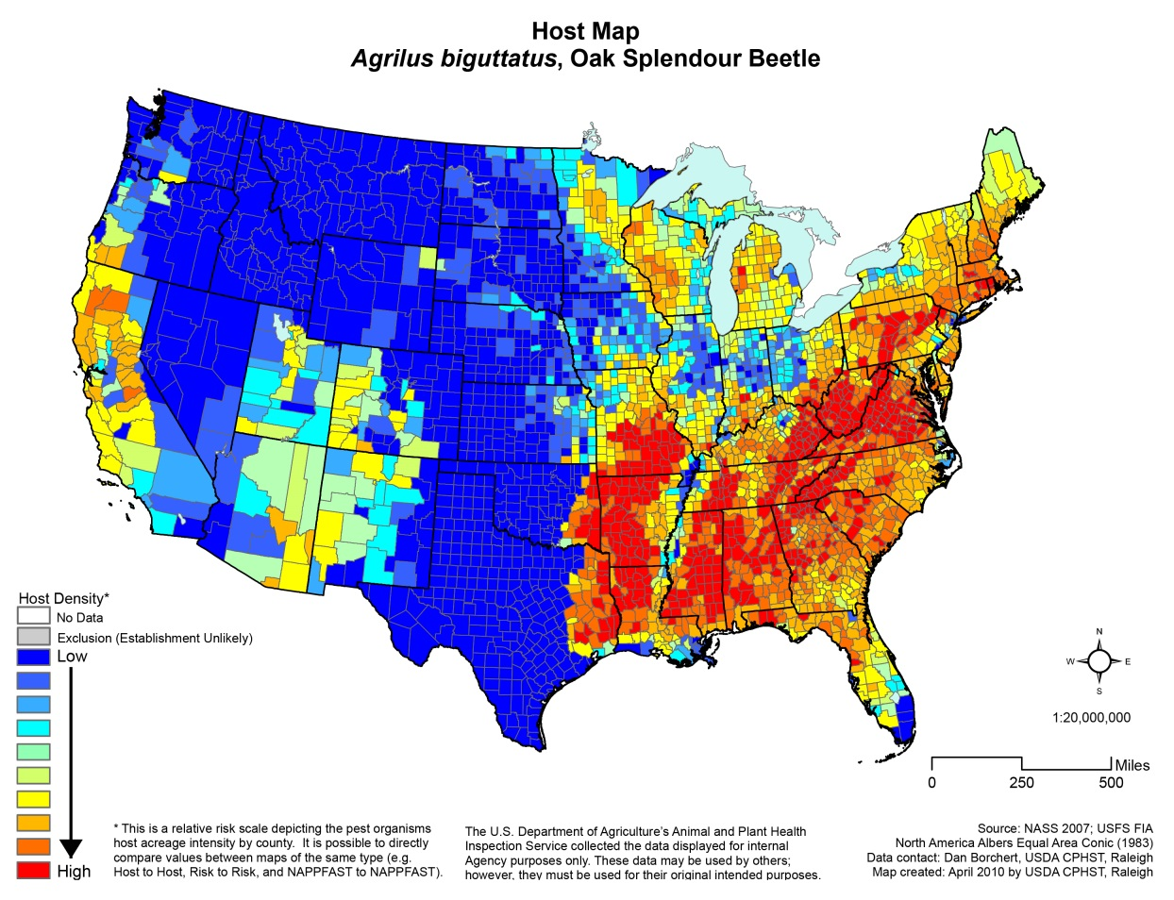
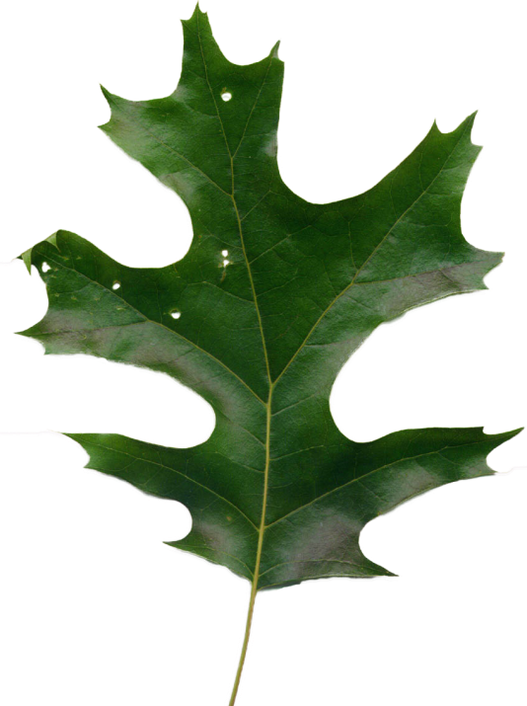
Host Availability
Medium/high
Preferred host species are oaks (Quercus spp.)
Reports of feeding on beech and chestnut but likely to be rare
NAPPFAST Host Map source: CERIS Pest Tracker
Notes:
The oak splendor beetle feeds primarily on oaks which are abundant and occur contiguously in the US.
Oaks are an important species in our forests and urban landscapes. They are important trees for lumber and flooring and planted widely as ornamental and landscape trees.
Within its native range, A. biguttatus tends to avoid feeding on the northern red oak, Quercus rubra.

Slide 12
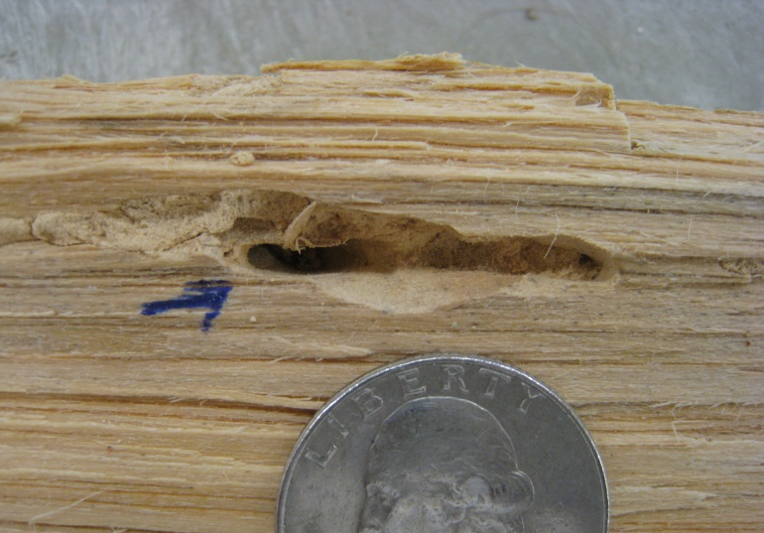
Entry Potential
Intercepted wood packaging material with buprestid damage.
Low — uncertain
Larvae may be difficult to detect during routine inspections at ports
Early records are incomplete and may only list interceptions as buprestids
Photos: © Peter Reagel, USDA APHIS PPQ CPHST
Notes:
A high degree of uncertainty is associated with this rating. Prior to 2004 records of Agrilus spp. interceptions may have been identified only to family Buprestidae. The majority of buprestid interceptions are associated with wood crating, wood packing materials and pallets which supports that larvae can be introduced unknowingly thus the uncertain rating.
There have been several significant Agrilus introductions over the years including the closely related emerald ash borer, Agrilus planipennis, and the goldspotted oak borer, Agrilus auroguttatus.

Slide 13
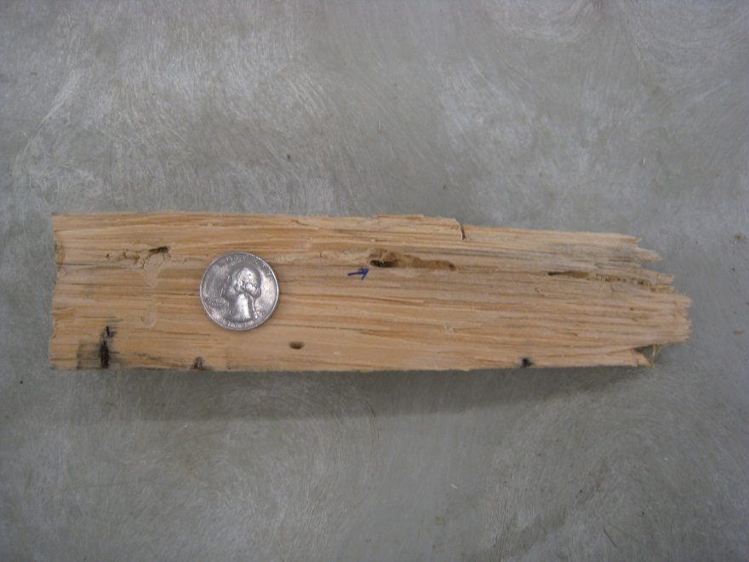
Establishment Potential
High
Much of the US has a suitable climate and host plants for establishment
Larval stages could be introduced unknowingly in wood products
Photo: © Peter Reagel USDA APHIS PPQ CPHST
Notes:
Despite the low entry potential rating, should this pest make its way into the country the establishment potential rates high. USDA’s initial predictions suggest that approximately 70% of the US has host availability and climate that could support populations of the oak splendor beetle.

Slide 14
Introduction pathways
Photo: © Larry R. Barber, USDA Forest Service, Bugwood.org
Notes:
Agrilus biguttatus is not known to be established in the United States. The likely pathway for introduction would be through wooden packing materials.

Slide 15
Introduction pathways
Larvae and pupae can be transported as hitchhikers in wooden packing material especially wood with bark intact.
All stages can be transported on host nursery plants in trade.
Photo: © USDA APHIS PPQ Archive, USDA APHIS PPQ, Bugwood.org
Notes:
Due to the cryptic nature of the pest and the availability of host material around ports of entry, there will always be the chance that the oak splendor beetle could be introduced. So having this pest on your radar is essential to finding it early before it can become widespread!
Larvae and pupae can be transported as hitchhikers in wooden packing material especially material with bark intact. Additionally, all life stages can be transported on plants moving in trade or in nursery stock.

Slide 16
Spread potential—natural dispersal
Adult beetles are capable of dispersing more than several km per year through its own movement or by abiotic factors (such as wind, water or vectors).
Newly established populations may go undetected for many years due to cryptic nature, concealed activity, slow development of damage symptoms or misdiagnosis.
Notes:
On its own, adults are strong fliers and on warm days potentially could fly a couple of miles in search of host material.

Slide 17
Spread potential—human assisted spread
Once introduced, larvae can be transported unknowingly in infested material including wood packing material or pallets from overseas
Like EAB, firewood is a potential pathway for long distance movement to new areas
Photo: © Joseph O'Brien, USDA Forest Service, Bugwood.org
Notes:
If the oak splendor beetle was to be introduced it has the potential to move long distances or to new locations the same ways that the emerald ash borer could move around, unknowingly in infested wood like pallets or firewood. This photo shows oak being used as firewood.

Slide 18
Insect biology
The genus Agrilus is a large genus within the family Buprestidae. It is well represented throughout North America and includes several familiar species including the bronze birch borer and the twolined chestnut borer.
Buprestid larvae are known as flatheaded wood borers and adults are brightly colored, metallic insects often known as jewel beetles.
Notes:
The genus Agrilus is a large genus within the family Buprestidae and is well represented in North American with about 100 native species. Several species are of economic importance. Familiar species include bronze birch borer, red-necked cane borer, bronze poplar borer, Gambel oak borer, and the twolined chestnut borer. The twolined chestnut borer, Agrilus bilineatus, occupies virtually the same ecological niche in North America that A. biguttatus occupies across Eurasia. Both species are contributing factors in oak decline and attack and kill severely stressed oaks.
Buprestid larvae feed in the cambium of trees or in the stems of small woody plants and may be referred to as flatheaded borers. Adults are colorful beetles with striking metallic colors and often referred to as jewel beetles.

Slide 19
Insect biology
A. biguttatus can complete its lifecycle in one year but more typically its life cycle requires two years.
Typically infestations are progressive and require 2–3 years to kill a tree. Highly infested trees can be killed in one season.
Notes:
Agrilus biguttatus may have one generation a year but a two-year cycle is more common. Typically infestations are progressive and require two to three years to kill a tree. In heavily infested trees, the entire main stem contains galleries and the trees are girdled and killed in a single season.

Slide 20
Notes:
Typically one generation develops over a two-year period. In addition to temperature, quality of host material, including moisture content of the wood, and pest density are also factors in how long it takes for larvae to develop.
Adults emerge in mid-spring through D-shaped exit holes in the bark surface around May–August. Adults feed on host tree foliage for maturation feeding and mate. Female beetles deposit clusters of 5-6 eggs in bark crevices of the host tree. Eggs hatch in 1–2 weeks. Newly hatched larvae bore into the cambium creating zigzag-shaped galleries. Young larvae overwinter. Larvae will begin to feed again once temperatures warm up in spring. Galleries of older larvae are wider and can reach up to 155 cm in length. Larvae go through five instars. Pupation occurs in the bark in individual chambers and adults emerge after two weeks.

Slide 21
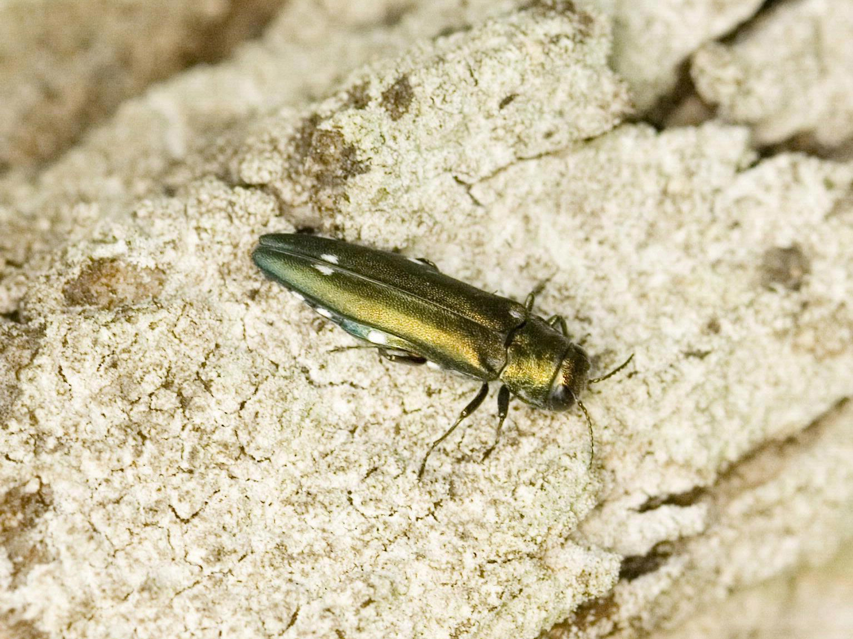
Adults
Photo: © Milan Zubrik, Forest Research Institute - Slovakia, Bugwood.org
Notes:
Agrilus biguttatus may be confused with indigenous and exotic buprestid species therefore, pupae and adults should be confirmed by a taxonomist.
However, some characters are common for buprestids and may help in keying a specimen to family or at least ruling out those insects which are not closely related.

Slide 22
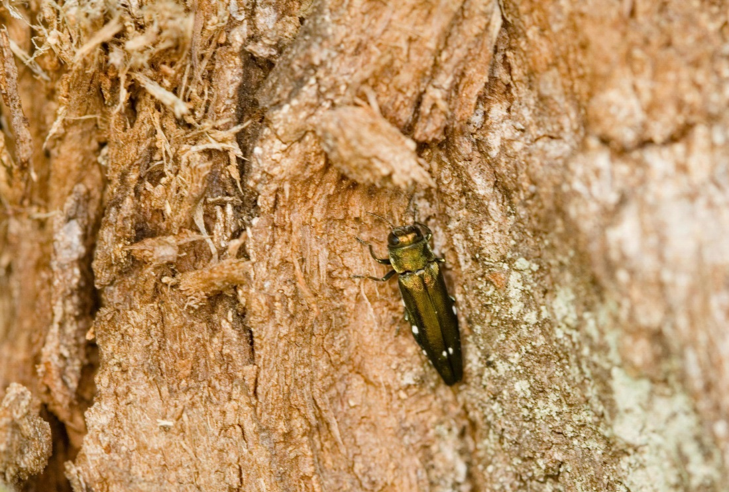
Identification—Adults
For diagnostic accuracy, the following descriptions are quoted from fs.fed.us
Adults are attractive, slender, sub-cylindrical insects, 9–12 mm long
Color is variable; often medium metallic green with bronze highlights
Two distinct white marks on their interior edge of their elytra
Photo: © Trevor and Dilys Pendleton
Photo: © Milan Zubrik, Forest Research Institute - Slovakia, Bugwood.org
Notes:
Adult beetles are slender and similar in appearance to the emerald ash borer. Often the color is medium metallic green with bronze highlights but individuals range from blue or gold in color. All have two distinct white spots on the elytra. The size of adults is approximately ¹⁄₃ – ½” in length.

Slide 23
Recognize the native twolined chestnut borer
Photos: © Kent Loeffler, Cornell University
Notes:
The native twolined chestnut borer, Agrilus bilineatus, feeds on the same host species that A. biguttatus would infest. Familiarize yourself with this native borer when you are scouting host trees under stress. The best way to confirm who is causing the damage is to recover adult beetles.

Slide 24
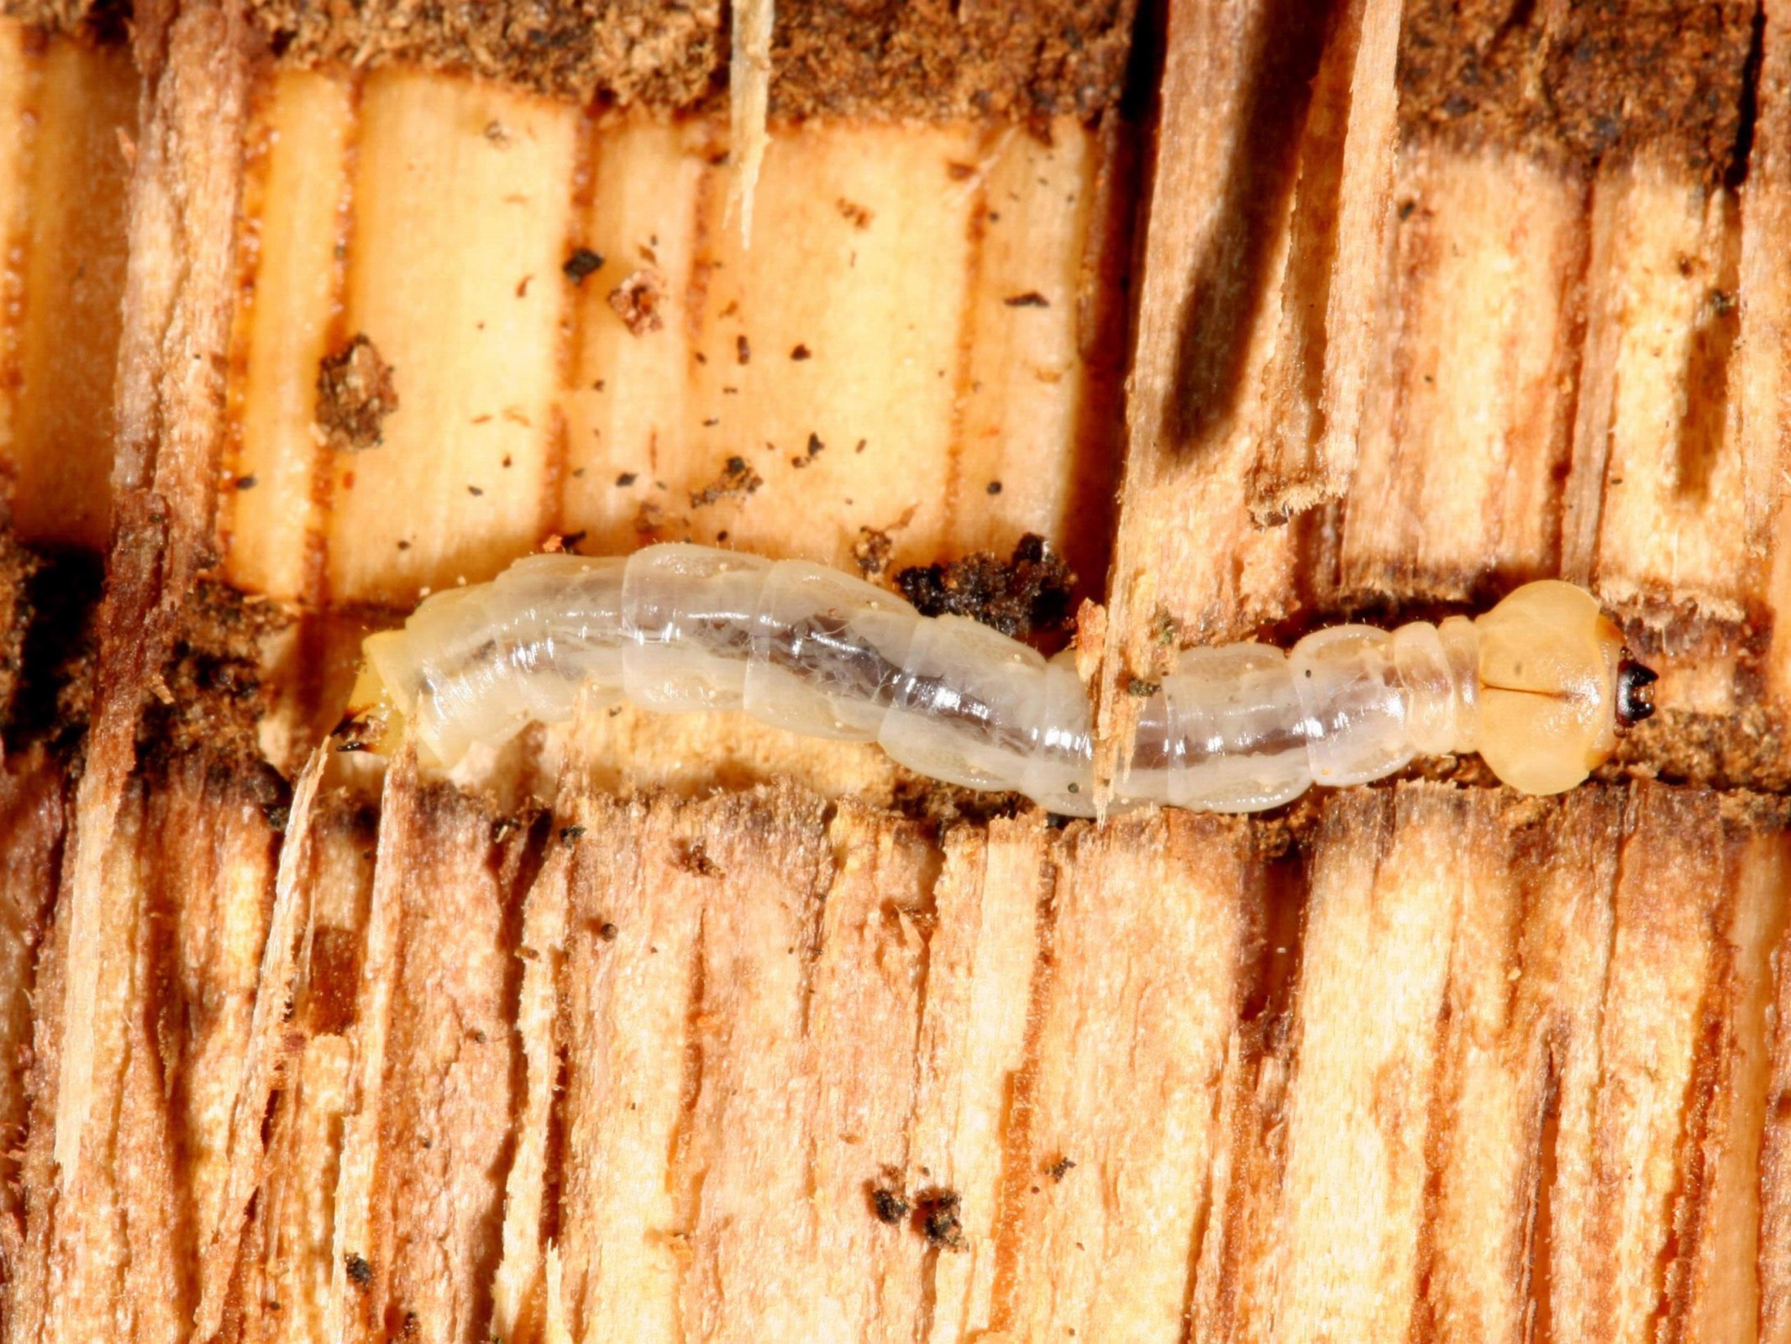
Larvae
Photo: © Gyorgy Csoka, Hungary Forest Research Institute, Bugwood.org
Notes:
Larvae have characteristic buprestid features—long, flat nested bell segments. Identification by a buprestid taxonomist would be necessary for confirmation.

Slide 25
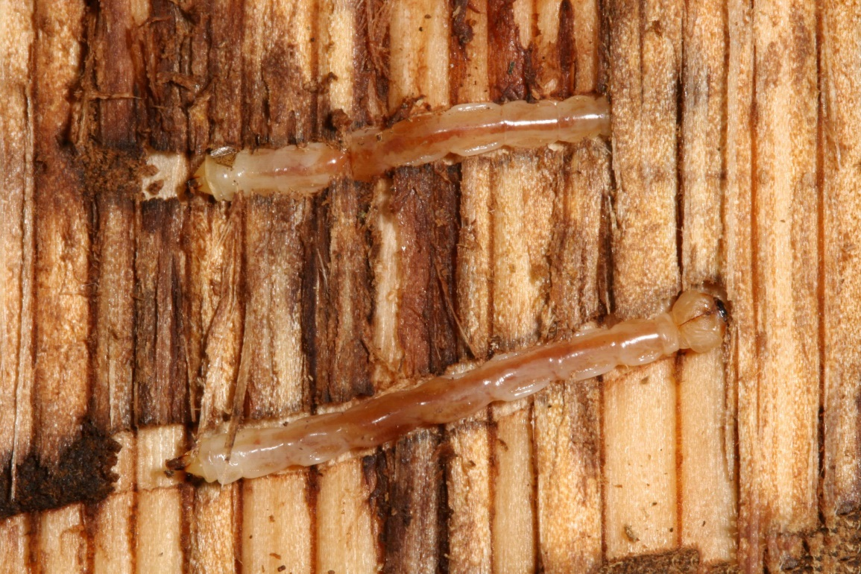
Identification—Larvae
For diagnostic accuracy, the following descriptions are quoted from fs.fed.us
Photo: © V. Meshkova, Ukrainian Research Institute of Forestry and Forest Melioration
The mature larvae are legless grubs, 25–43 mm long [approx. 1 in to 1 ¹¹⁄₁₆ in] when mature and creamy white in color.
The first thoracic segment is wider than the other body segments.
Two hornlike projections are found on the last abdominal segment.
Photo: © G. Csoka, Hungary Forest Research Institute, Bugwood.org
Notes:
Agrilus biguttatus larvae are legless grubs, reaching 25–43 mm long when mature (roughly an inch to just over an inch and a half) and creamy white in color. The first thoracic segment is wider than the other body segments. This species has two hornlike projections on the last abdominal segment.

Slide 26
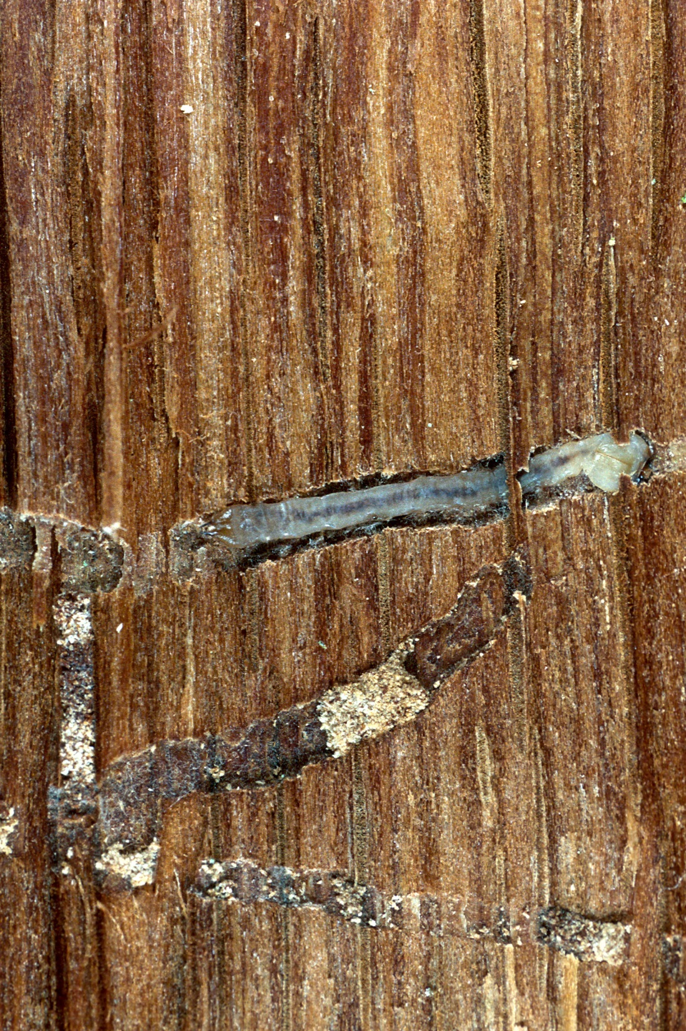
Larvae
Photos: © Louis-Michel Nageleisen, Département de la Santé des Forêts, Bugwood.org
Notes:
Agrilus biguttatus have five larval instars.

Slide 27
Larvae
Photo: © Louis-Michel Nageleisen, Département de la Santé des Forêts, Bugwood.org
Notes:
When larvae are fully grown they migrate to the bark where they go into this j-shape position, overwinter and then pupate.

Slide 28
Identification—Pupae
For diagnostic accuracy, the following descriptions are quoted from fs.fed.us
White
Found in individual chambers within the bark
Photo: © Louis-Michel Nageleisen, Département de la Santé des Forêts, Bugwood.org
Notes:
Pupae are white and can be found within individual chambers in the bark.

Slide 29
Hosts
Oak (Quercus) is the main host
Within their native range they rarely infest northern red oak, Quercus rubra
European chestnut and European beech are also susceptible
These host trees are subject to attack by the native twolined chestnut borer
Photo: © Leif Knutsen, wikimedia commons
Notes:
The primary hosts of Agrilus biguttatus are oaks. Infestations in the northern red oak, Quercus rubra, planted within the geographic range of A. biguttatus, are rare (Moraal and Hilszanski 2000).
Infestations are found occasionally in European beech, Fagus sylvatica and European chestnut, Castanea sativa. Several records exist of this insect attacking poplars, Populus spp, but scientists feel that these were likely misdiagnosed.
In the eastern and central U.S. and Canada these host trees are subject to attack by the native Agrilus bilineatus, twolined chestnut borer.

Slide 30
Signs and symptoms
Photo: © Andrea Battisti, Universita di Padova, Bugwood.org
Notes:
Other pests and diseases as well as abiotic disorders such as drought can cause similar symptoms to those caused by an oak splendor beetle infestation. Additionally, signs caused by native Agrilus spp. will also look the same. Closely monitor oak trees which are under stress because this pest prefers weakened and stressed trees.

Slide 31
Symptoms
Thinned crowns and tree mortality
Twig and branch dieback
Development of epicormic shoots
Photo: © Louis-Michel Nageleisen, Département de la Santé des Forêts, Bugwood.org
Notes:
Symptoms of attack include dieback, development of epicormic branches, thin crown and tree mortality. These symptoms and those which follow also apply to general oak decline and subsequent attack by the native species Agrilus bilineatus.

Slide 32
Symptoms
Dark cracks and discoloration of bark and cambial tissue may occur over the galleries
Woodpecker activity
Photo: © Andrea Battisti, Universita di Padova, Bugwood.org
Notes:
Dark cracks or oozing from the bark can be a symptom of oak decline. Woodpecker activity would indicate that there are borers present.

Slide 33
Signs
Photos: © Trevor and Dilys Pendleton
D-shaped exit holes (2.5–4 by 2–3 mm) on the bark surface created by emerging adults.
About the size of an emerald ash borer exit hole.
Notes:
D-shaped adult exit holes are characteristic of buprestid beetles. Native buprestid beetles also leave d-shaped exit holes.

Slide 34
Signs
D-shaped exit holes
Frass filled larval galleries may be observed if bark is removed
Photo: © M.G. Volkovich
Notes:
More frass filled galleries and exit holes with the bark removed.

Slide 35
Signs
Young larvae tend to create stepped galleries.
Zigzag, frass-filled larval galleries up to 155 cm long within inner bark.
Photo: © Louis-Michel Nageleisen, Département de la Santé des Forêts, Bugwood.org
Photo: © Valentyna Meshkova, Ukrainian Research Institute of Forestry and Forest Melioration, Bugwood.org
Notes:
Oak splendor beetle larvae create winding galleries in the cambium layer. Often times the galleries are filled with frass and may be transverse or stepped.
Don’t forget, the presence of insect life stages is a great sign and helpful to confirm if it is in fact OSB that is causing symptoms on your oak.

Slide 36
Scouting—become familiar with our native borers
Early symptoms of twolined chestnut borer attack on white oak. Dead and dying branches in the upper crown.
“Detection of A. biguttatus is significantly more complex than detection of emerald ash borer, A. planipennis. In the case of emerald ash borer, there are no native species of Agrilus that attack ash in North America. Therefore, the presence of dead and dying branches, winding galleries and D-shaped exit holes are a good indicator that A. planipennis may be involved. This is not the case with oaks, especially oaks within the range of Agrilus bilineatus.”
–William M. Ciesla, Forest Health Management International
Photo:
Photo: © Steven Katovich, USDA Forest Service, Bugwood.org
Notes:
The following scouting recommendations will most likely detect infestations of the native Agrilus bilineatus, who also attacks stressed oak trees. However early detection is critical if a high-consequence pest is to be eradicated therefore we still recommend that you monitor host trees, especially those under stress. If you find symptoms or signs described in this presentation that would suggest a buprestid beetle infestation—look more closely. The only way to know for sure if Agrilus biguttatus is present is to recover and identify adults.

Slide 37
Scouting
Trees defoliated by gypsy moth.
Prefer
Stressed trees
Drought stressed
Urban conditions including compacted soils or poor drainage
Diseased or defoliated trees
Larger trees (12–16″ DBH)
Photo: © Bill McNee, Wisconsin Dept of Natural Resources, Bugwood.org
Notes:
It is ideal to be on the lookout for unusual plant symptoms year round but you can use the following tips as a guide for when to look more closely for the symptoms and signs described here.
This pest prefers larger, stressed oak trees—prioritize oaks which are stressed by injury or disease, adverse weather conditions, planted in poor or compacted soils or have been defoliated by another insect pest such as gypsy moth.

Slide 38
Scouting
Symptoms of oak decline on pin oak.
Look for host trees that show these symptoms
Thin crowns
Epicormic shoots
Branch and tree dieback
Bark splits
Weeping sap from trunk
Photo: © Joseph O'Brien, USDA Forest Service, Bugwood.org
Notes:
Look for the common symptoms which include dieback, thinning, epicormic sprouting, bark splits and weeping or oozing from the trunk.
Look for canopy thinning, branch dieback and epicormic sprouting when trees have foliage.

Slide 39
Scouting
Woodpecker activity anytime of year. Easiest to see damage when leaves are off.
D-shaped exit holes
Adult beetles most active mid-spring to summer (May to July).
Photo: © Milan Zubrik, Forest Research Institute - Slovakia, Bugwood.org
Notes:
Woodpecker activity can be seen any time of year but may be easiest to notice during the winter and early spring when leaves are off of the trees.
While scouting if you find trees with these symptoms look more closely for signs of an infestation including D-shaped exit holes or adult beetles. The twolined chestnut borer is a closely related native buprestid but its exit hole will be slightly larger than that of the oak splendor beetle. The only way to establish if A. biguttatus is present is to recover and identify adults.
Adult beetles are not easy to find but are the best way to confirm an identification. Adult beetles will be most active during May—July when they are mating, laying eggs and feeding on oak foliage.

Slide 40
What you should do…
If you see signs and symptoms described in this presentation on Quercus spp. look more closely for signs of the insect.
Agrilus biguttatus is a high-consequence insect pest of quarantine significance. It is not currently known to be established in the United States.
Symptoms of A. biguttatus are similar to those caused by other less serious pests.

Slide 41
Contact your state NPDN lab…
If you think you have found Agrilus biguttatus contact the NPDN diagnostician in your state immediately.
Take a series of quality photographs and send them to the diagnostician then ask about sending in a physical sample.
If the diagnostician asks you to send a physical sample…

Slide 42
Send in a proper sample…
Remember when sending samples that are considered to be significant or high-consequence these tips…
Capture multiple, whole specimens if possible
Kill insects by placing them in the freezer for 24 hours.
Loosely wrap insects in tissue and place in a small crush proof container or sturdy lockable bag
Place container or bag in another lockable bag
Place these in a sturdy shipping container
Include ALL of the proper sample submission forms required by your NPDN lab
Review NPDN’s sample submission module and contact your state diagnostician with any questions.
Notes:
Remember when sending samples that are considered to be significant or high-consequence these tips…
Capture multiple, whole specimens if possible.
Kill insects by placing them in the freezer for 24 hours.
Loosely wrap insects in tissue and place in a small crush proof container or sturdy lockable bag
Place container or bag in another lockable bag
Place these in a sturdy shipping container
Include ALL of the proper sample submission forms required by your NPDN lab
Review NPDN’s sample submission module and contact your state diagnostician if you have sample collecting or packaging questions.

Slide 43
References
Ciesla, W. M. Agrilus biguttatus. EXFOR database pest report. 2003. (Exotic Forest Health Website (Exfor)
CPHST. Agrilus biguttatus datasheet. Exotic wood borer/bark beetle survey reference. [pdf file]. <http://caps.ceris.purdue.edu/webfm_send/1975>
Davis, E. E., S. French, and R. C. Venette. 2005. Mini risk assessment: metallic beetle: Agrilus biguttatus Fabricius [Coleoptera: Buprestidae].
Hilszczański, J. and A. Sierpinski. 2006. Agrilus spp. the main factor of oak decline in Poland.
Michigan State University’s invasive species factsheets. “Oak splendor beetle Agrilus biguttatus.”
Moraal, L. G. and J. Hilszczanski. 2000. The oak buprestid beetle, Agrilus biguttatus (F.) (Col., Buprestidae), a recent factor in oak decline in Europe.
Silagyi, A. E., L. D. Jackson, N. K. Campbell, and Avraham Eitam. 2010. Survey Guideline for Agrilus biguttatus, (Coleoptera: Buprestidae), the oak splendor beetle.

Slide 44
Questions
on this module or the NPDN contact Rachel McCarthy at rachel.mccarthy@cornell.edu
on how to collect or submit a sample contact your state NPDN diagnostician at www.npdn.org

Slide 45
Author credits
Rachel McCarthy, NPDN-SPN Manager, Plant Pathology and Plant-Microbe Biology, Cornell University

Slide 46
Reviewer credits
William M. Ciesla, Forest Health Management International, Fort Collins, Colorado
Dawn Dailey O’Brien, Plant Pathology and Plant-Microbe Biology, Cornell University

Slide 47
Publication details
This publication can be used for non-profit, educational use only purposes. Photographers retain copyright to photographs or other images contained in this publication as cited. Authors and the website should be properly cited. Images or photographs should also be properly cited and credited to the original source.
Published—August 2014

Slide 48
The Sentinel Plant Network
The Sentinel Plant Network (SPN) is a collaboration between the American Public Gardens Association (APGA) and the National Plant Diagnostic Network (NPDN) and is funded through the USDA’s Animal and Plant Health Inspection Service (APHIS).
Notes:
We believe that the never ending battle to slow or stop exotic pest and pathogen introductions can best be waged by the combined efforts of two organizations with similar goals.
The partnership, dubbed the Sentinel Plant Network is a cooperative project between the American Public Gardens Association (APGA) and the National Plant Diagnostic Network (NPDN) with funds for cementing the union coming from USDA-APHIS.
The Sentinel Plant Network is expected to enhance diagnostic capabilities via improved communication between public gardens and expert diagnostic facilities with access to advanced technologies.

Slide 49
The Sentinel Plant Network’s Mission
The Sentinel Plant Network contributes to plant conservation by engaging public garden professionals, volunteers and visitors in the detection and diagnosis of high-consequence pests and pathogens.
For more information on the Sentinel Plant Network visit www.sentinelplantnetwork.org

